Slide 1
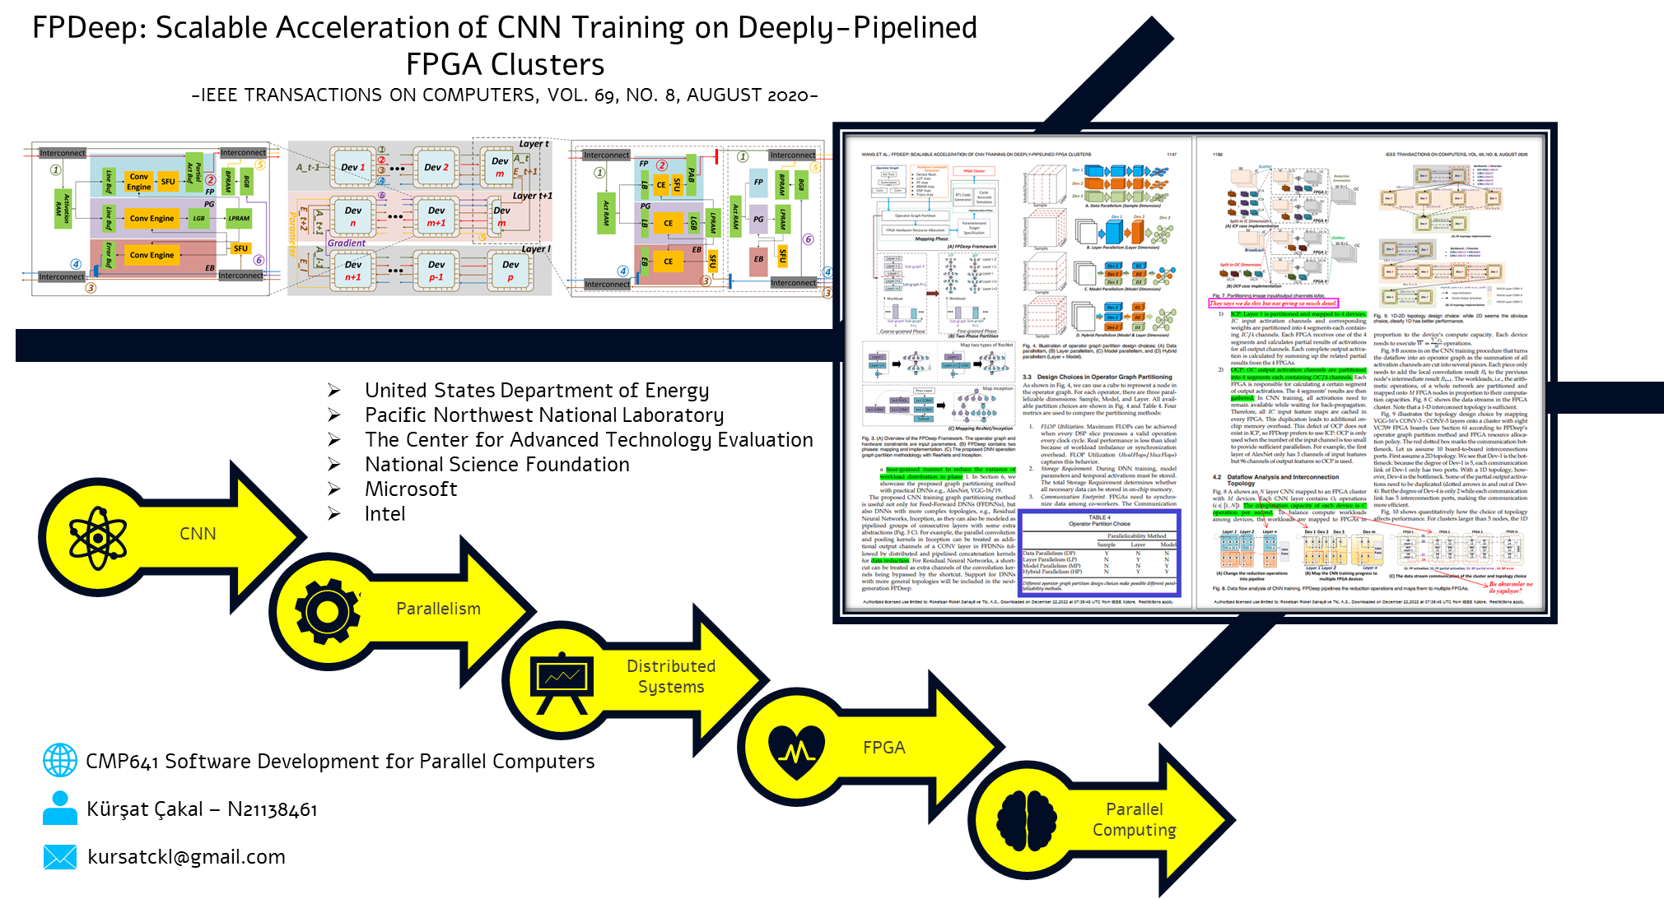

Slide 2
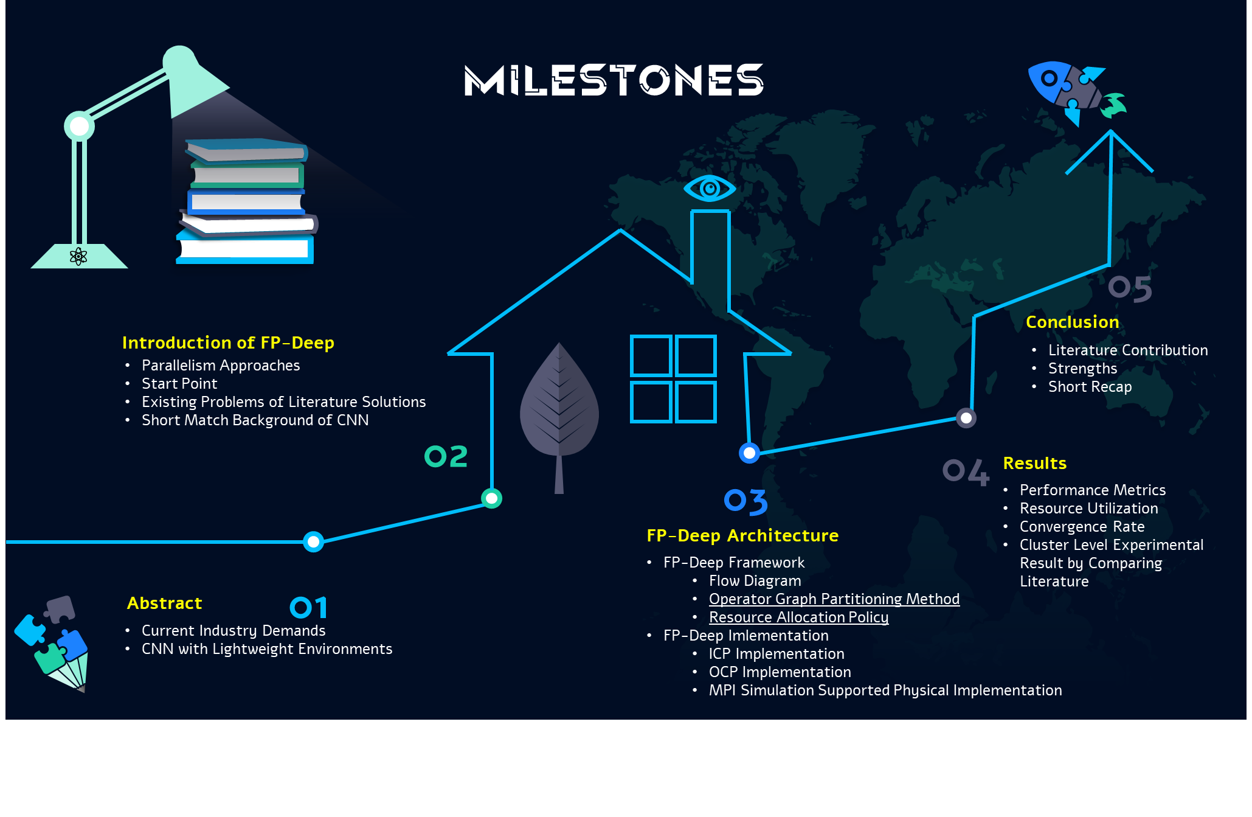

Slide 3
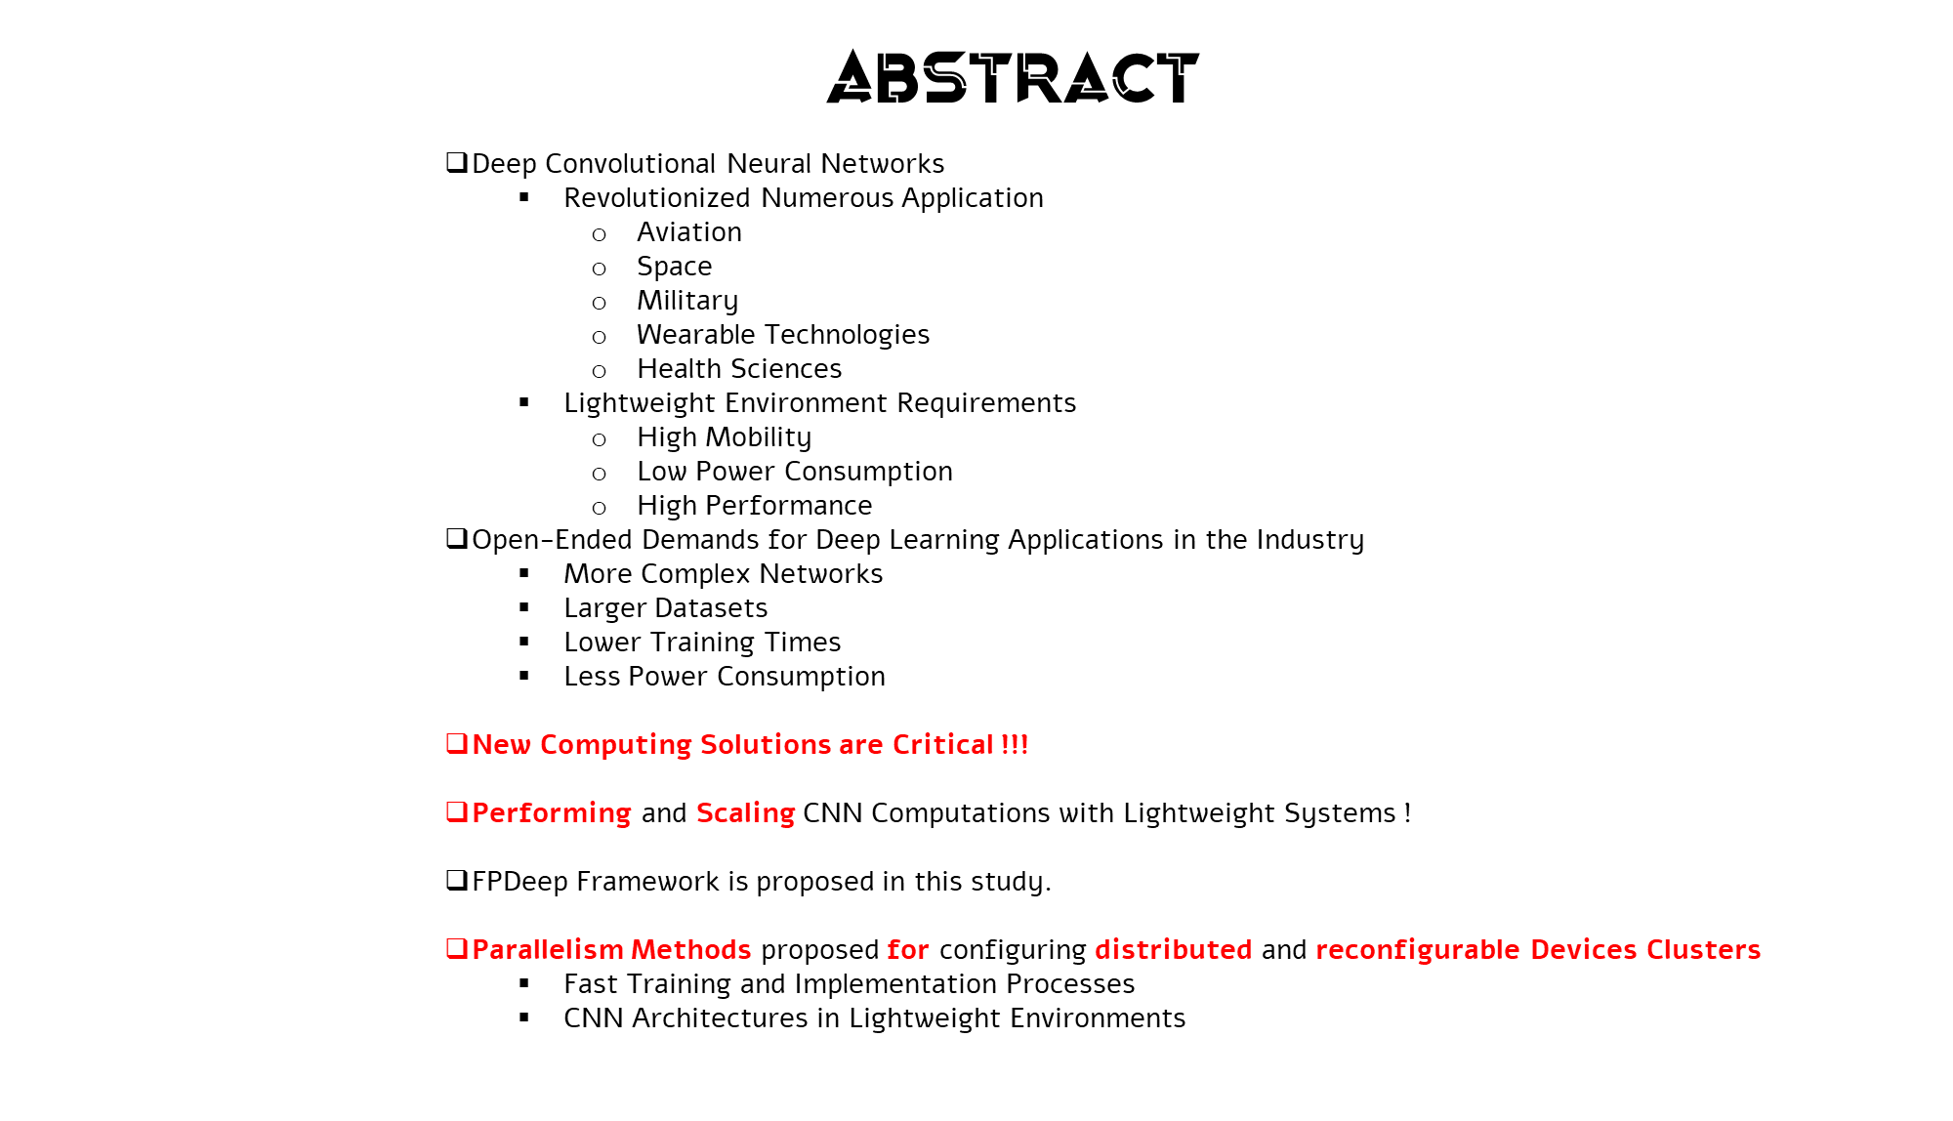
Notes:
They examines the needs of CNN working principles and propose solutions for each steps

Slide 4
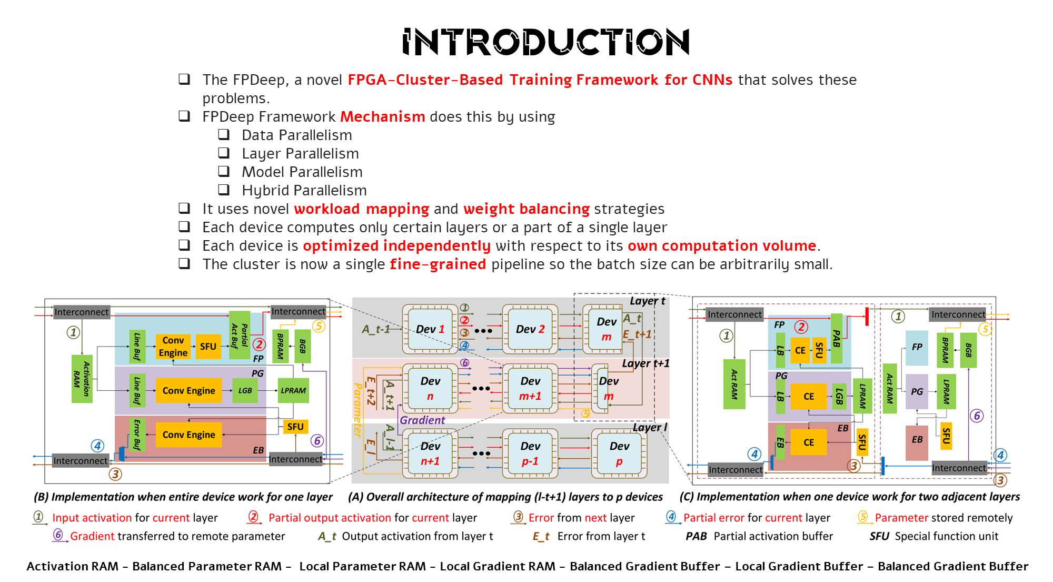

Slide 5
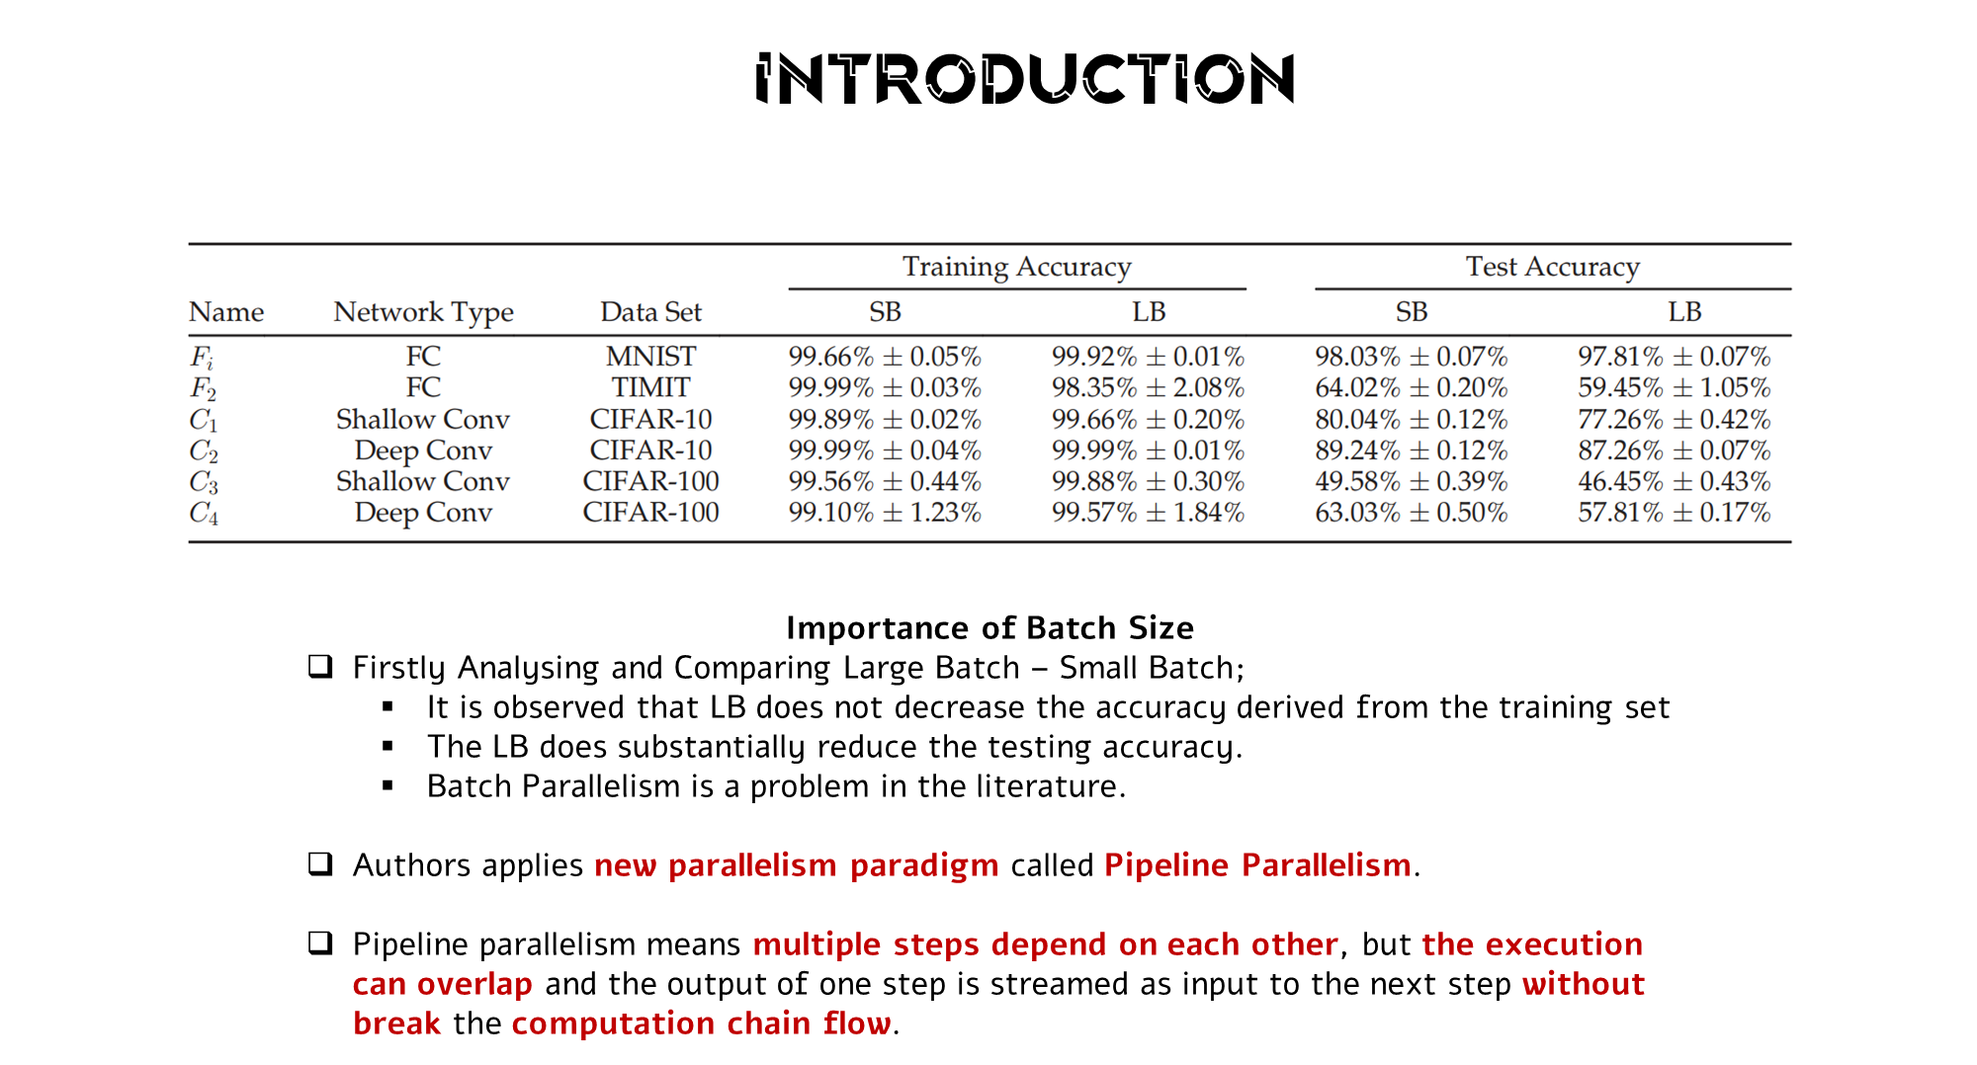

Slide 6
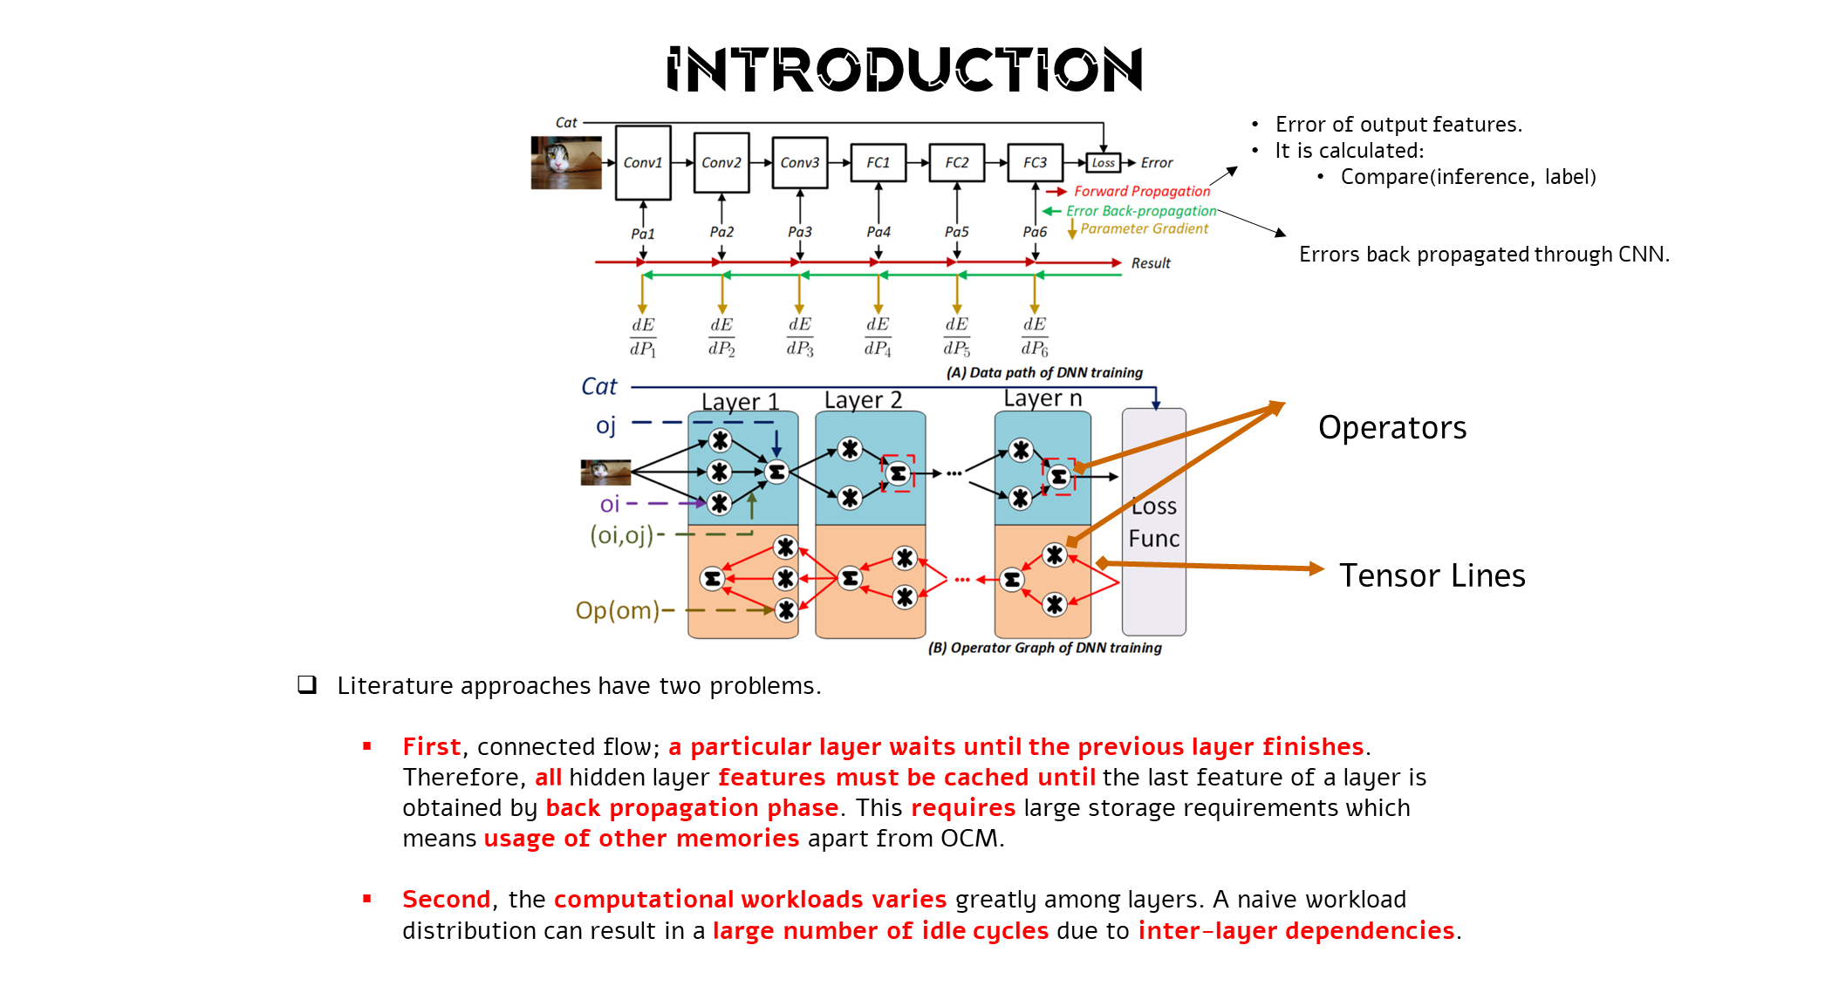
Notes:
Fig. 1. (A) Illustration of computations involved in CNN training including datapaths for forward and backward propagation and parameter gradient update.
(B) An operator graph is used to represent DNN training. Nodes are operators and edges are tensors.

Slide 7
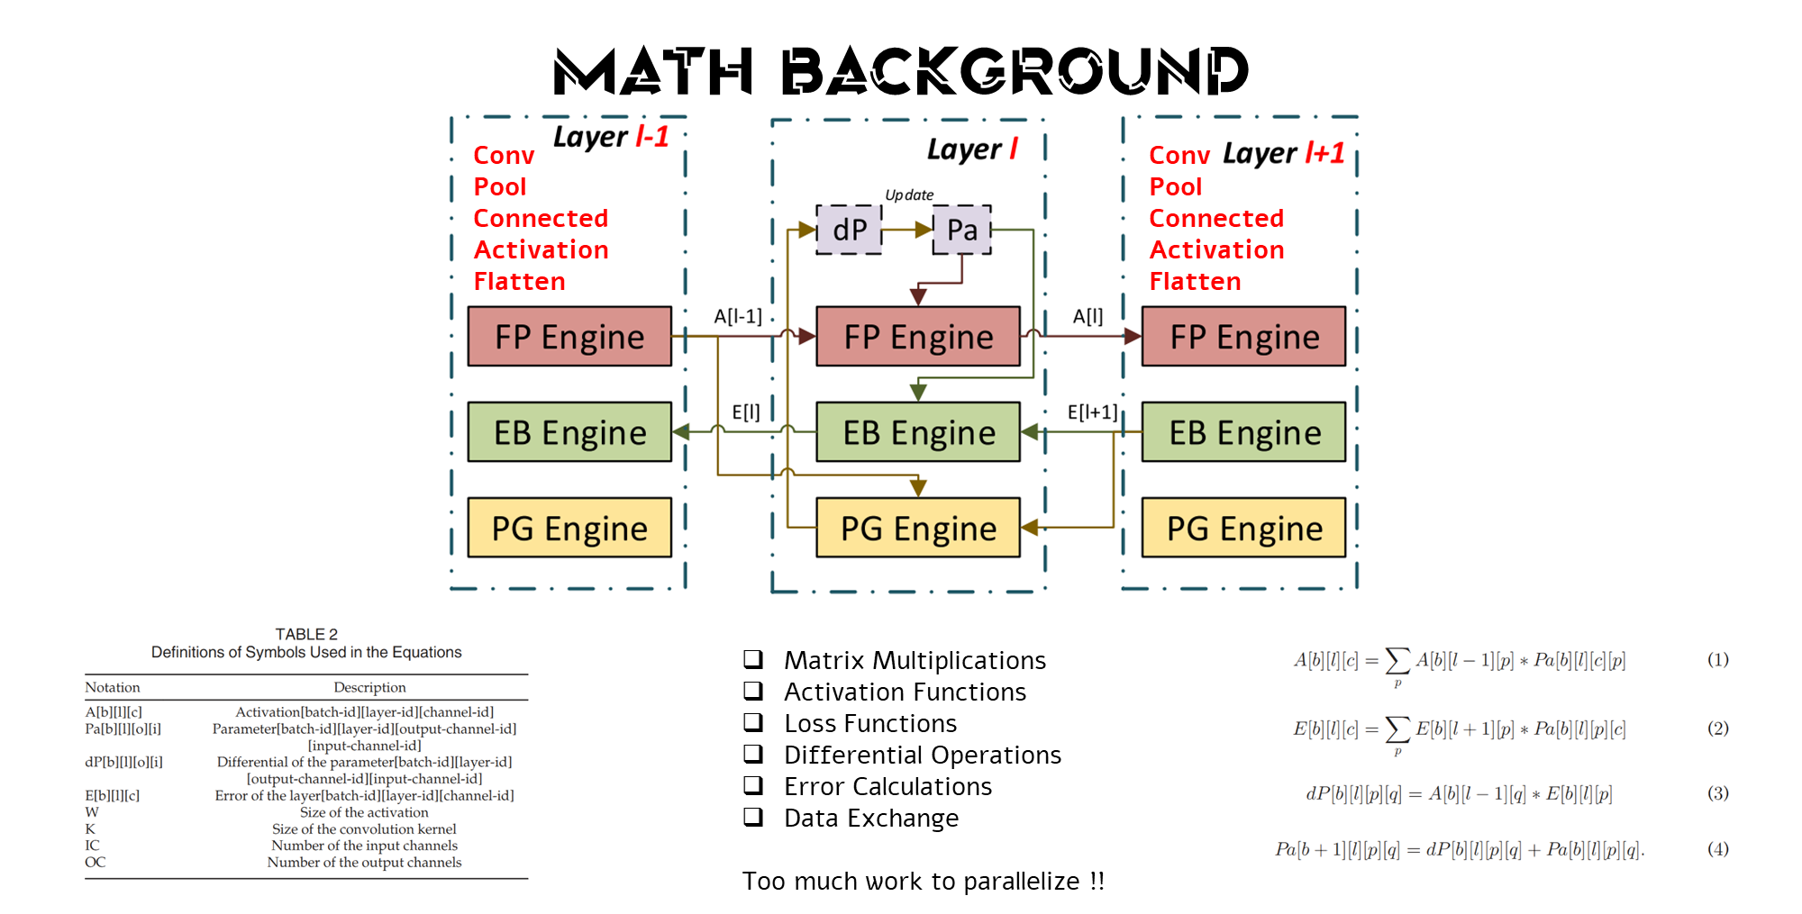
Notes:
A → Activation
E → Error
dP → Differential
P → Parameters

Slide 8
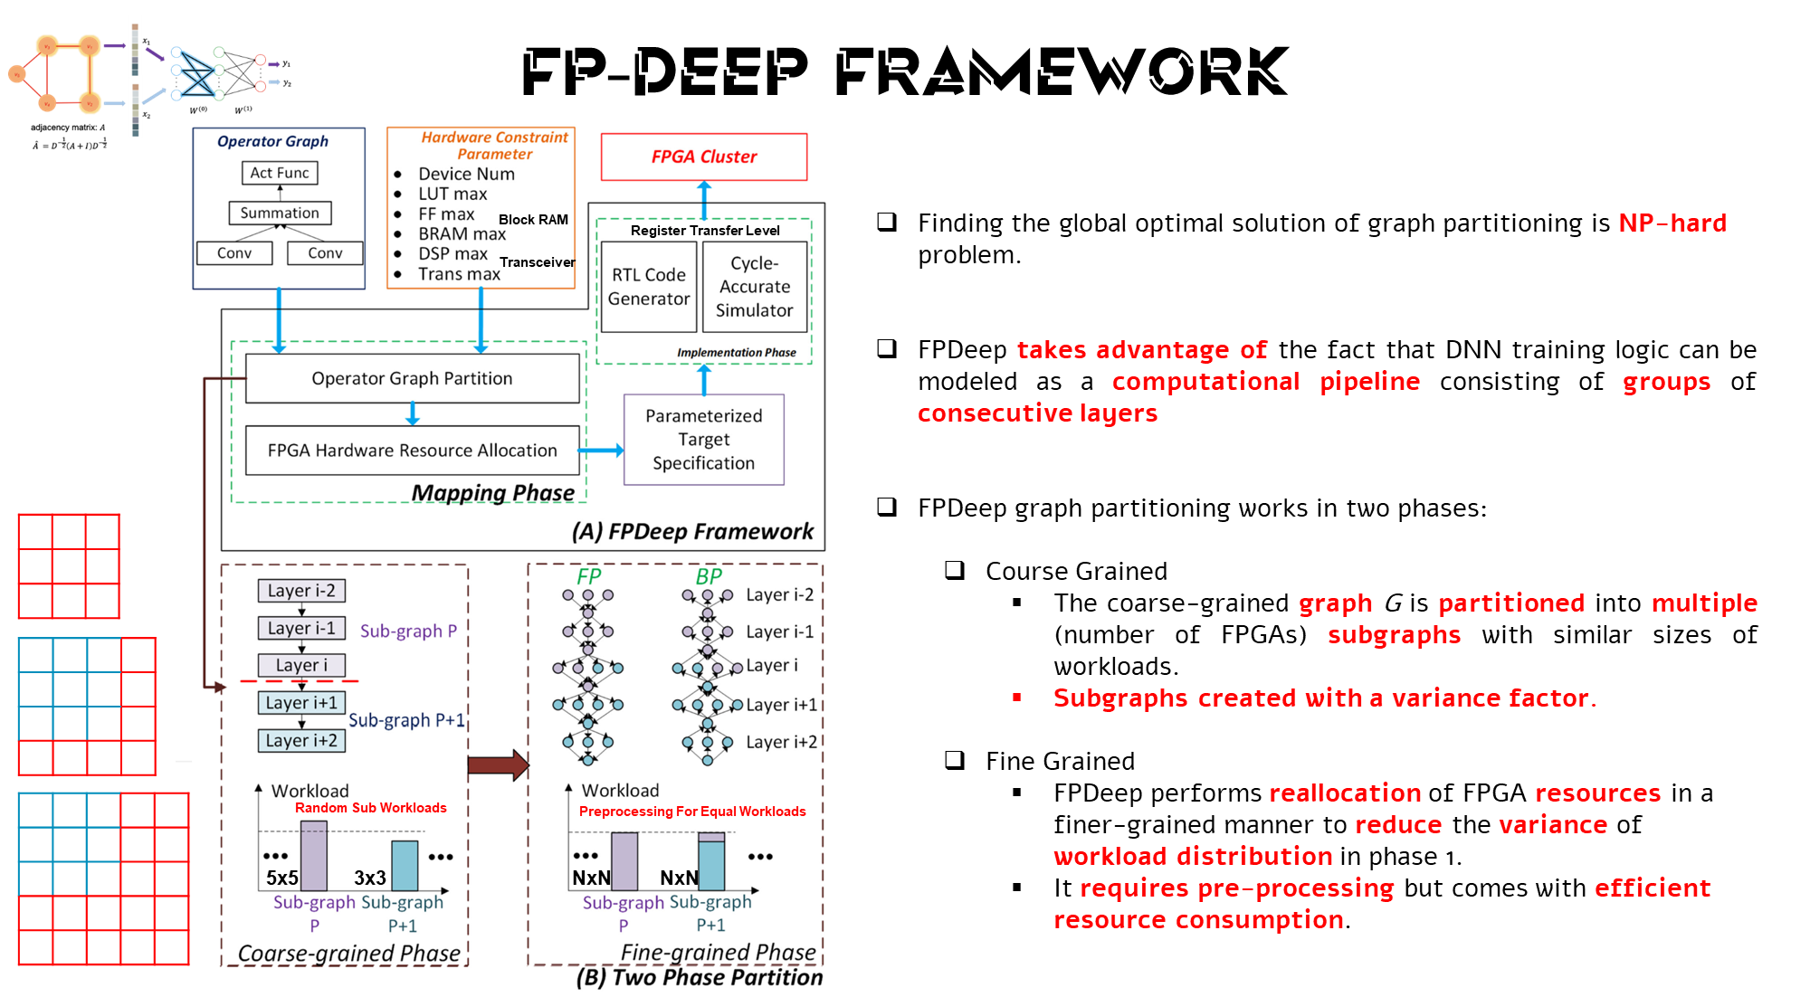
Notes:
FPDeep thus has two sets of input parameters, from the Operator Graph and the Hardware Constraint Parameters.
The whole framework contains two parts: mapping and implementation (Fig.3(A)).
The Mapping Framework partitions the operator graph into several fine-grained segments and maps them onto FPGA clusters so that every
FPGA gets a balanced workload and parameters.

Slide 9
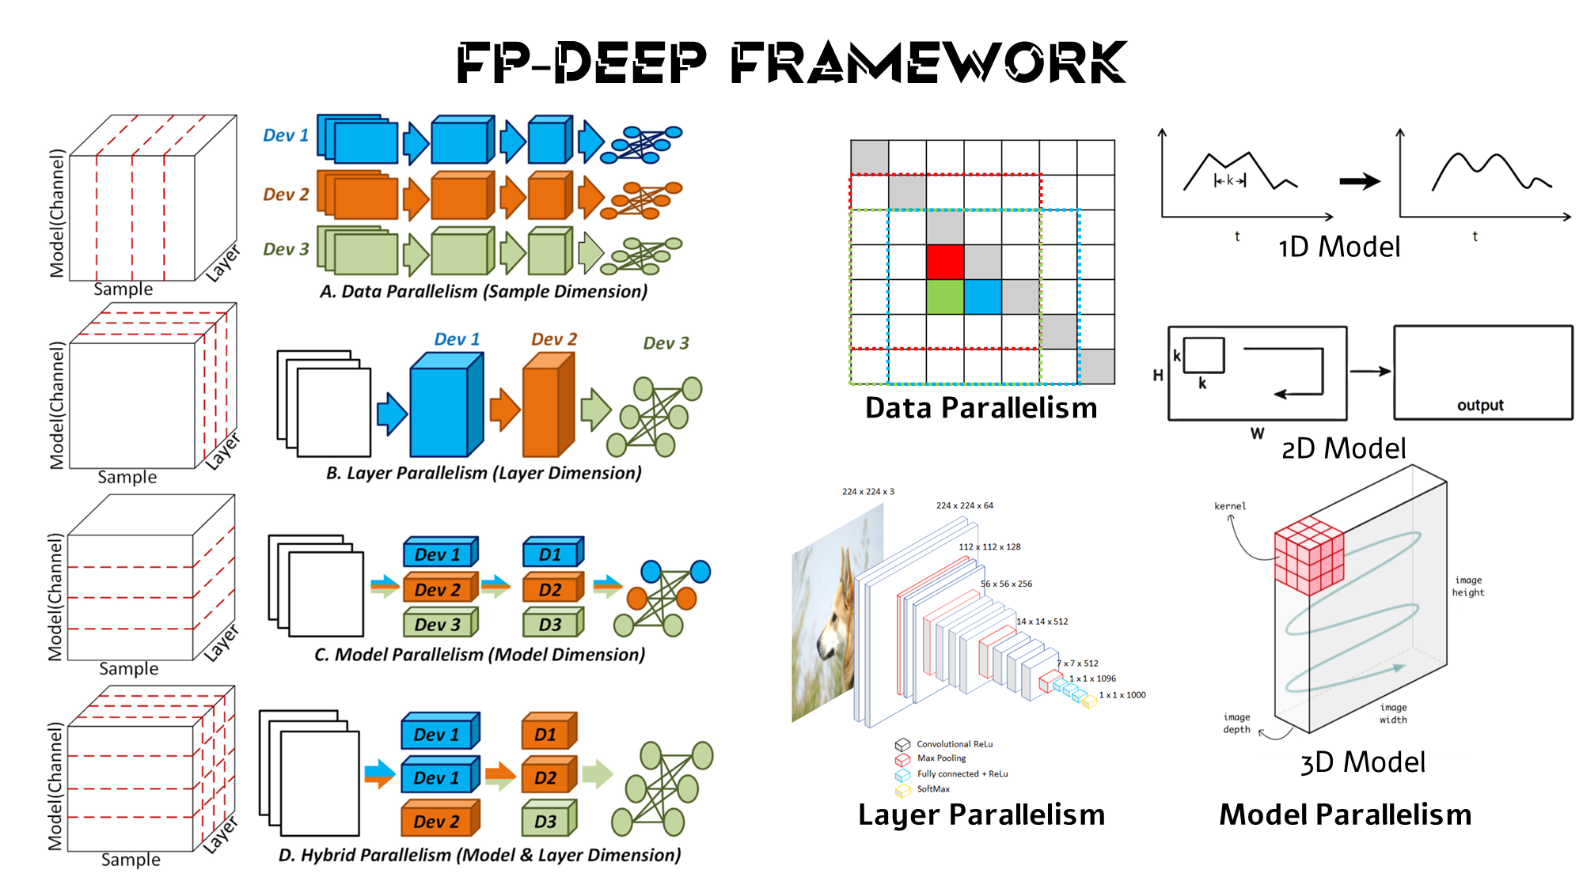
Notes:
Motivasyonundan bol bol bahset
As all we know, our life style changes day by day with increasing industry needs.
This brings our life some unhealthy routines like our diet types, form of entertainment, sport activities and etc.
Then, it is result with hypertension, obesity, diabetes and more.
At the end of the day, it causes crucial rates of moralities and deaths because of heart attacks and strokes.
My motivation is proposing a novel approach that can be present an early detection mechanism.
I am developing a novel CNN based algorithm for the daily usage in the wearable devices.
It is called Cardiovascular Anomaly Classification and I will use ECG Measurements and Metrics that collected by Holter Devices.
This study requires some biological reading related with Cardiovascular System as well as Computer Science
As a results we are getting some anomaly details according to each signal class.
Kısaca problemden bahset.
Anormalliklerin yabancı görülebileceğini sağlık bilimsel tanımlamalarını kendinin analiz ettiğini fakat burada çok detaylara değinmeyeceğini bildir.
Bu probleme karşı yeni bir algoritma geliştireceğini bunun CNN temelli olduğunu
What if we could make some inferences related to our health status in real time?
This project requires some biological readings in addition to computer sciences. I added some definitions because it looks so strange for the first look. But at the end of the day, we will have early detection mechanism for such kind of diseases.
For example, after some year it is possible to have Fatty Deposits in our arters.

Slide 10
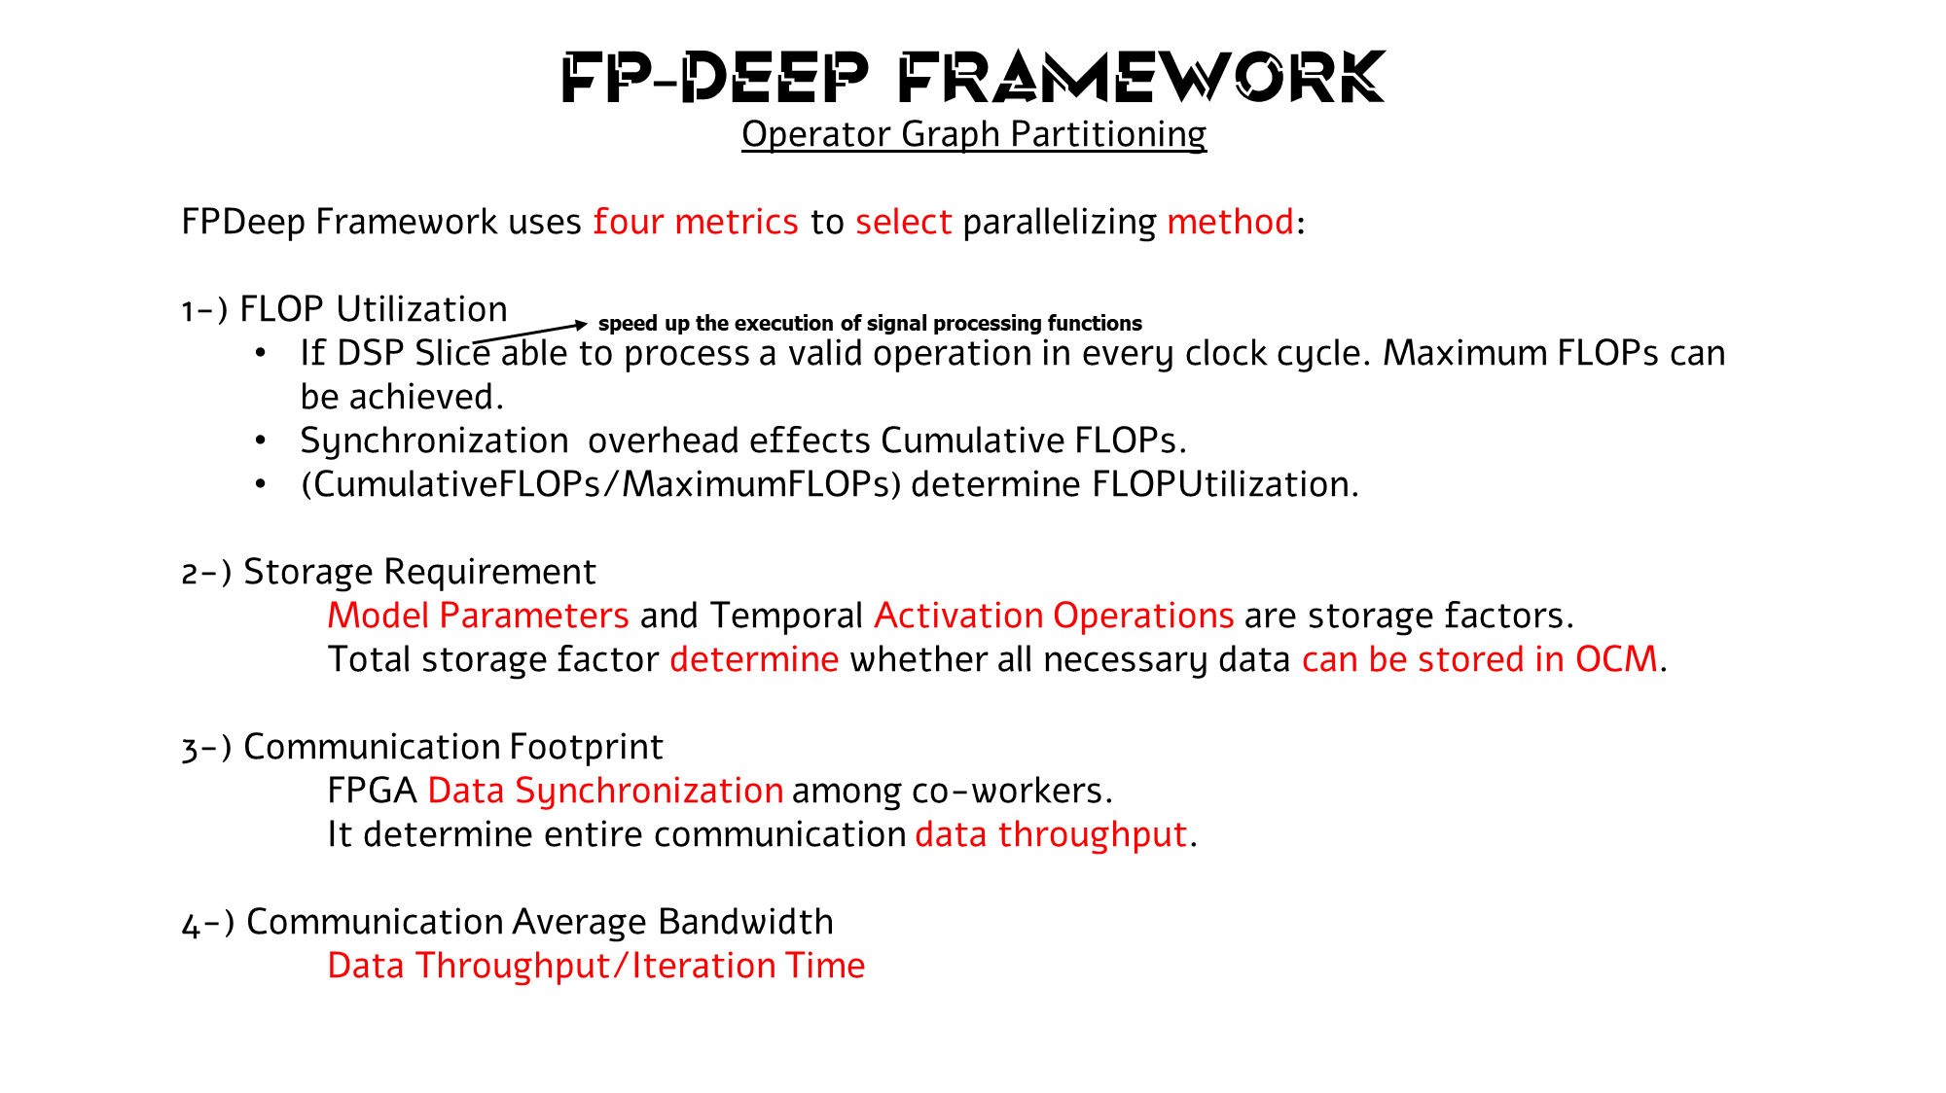
Notes:
Analizleri yaparak CNN Mimarisine göre neye ihtiyacı olduğunu anlar ve Hybrid bir çözüm sunma kabiliyeti ortaya koyar.
Operator Graph Partitioning Model realizes this.

Slide 11
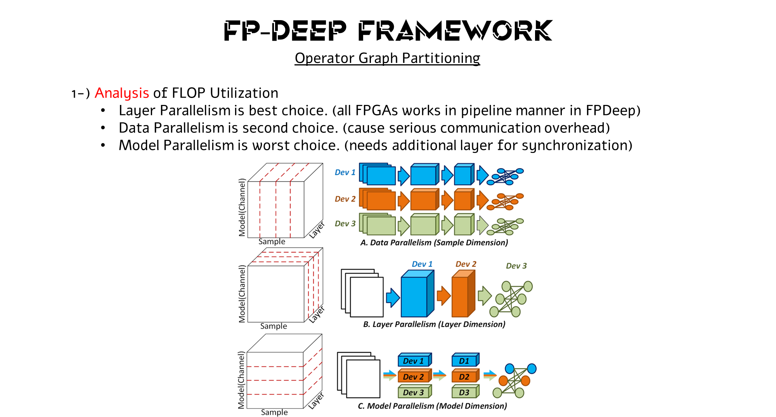
Notes:
Analizleri yaparak CNN Mimarisine göre neye ihtiyacı olduğunu anlar ve Hybrid bir çözüm sunma kabiliyeti ortaya koyar.
Operator Graph Partitioning Model realizes this.

Slide 12
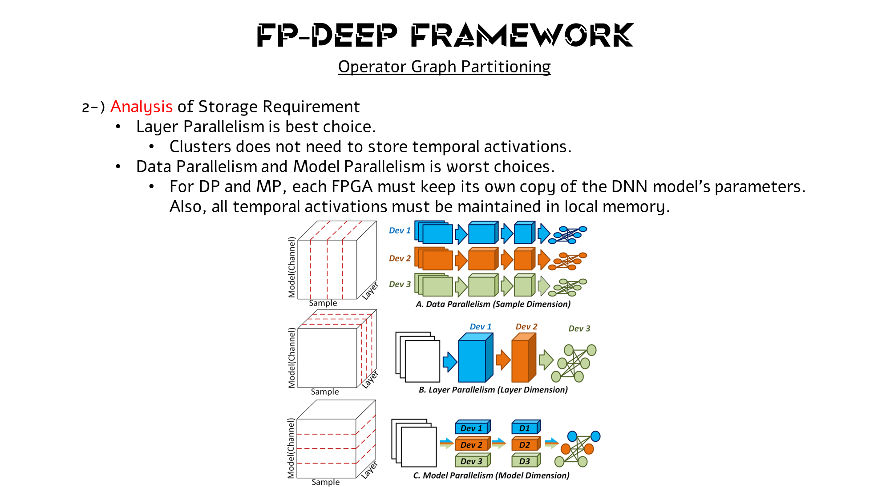
Notes:
Analizleri yaparak CNN Mimarisine göre neye ihtiyacı olduğunu anlar ve Hybrid bir çözüm sunma kabiliyeti ortaya koyar.
Operator Graph Partitioning Model realizes this.

Slide 13
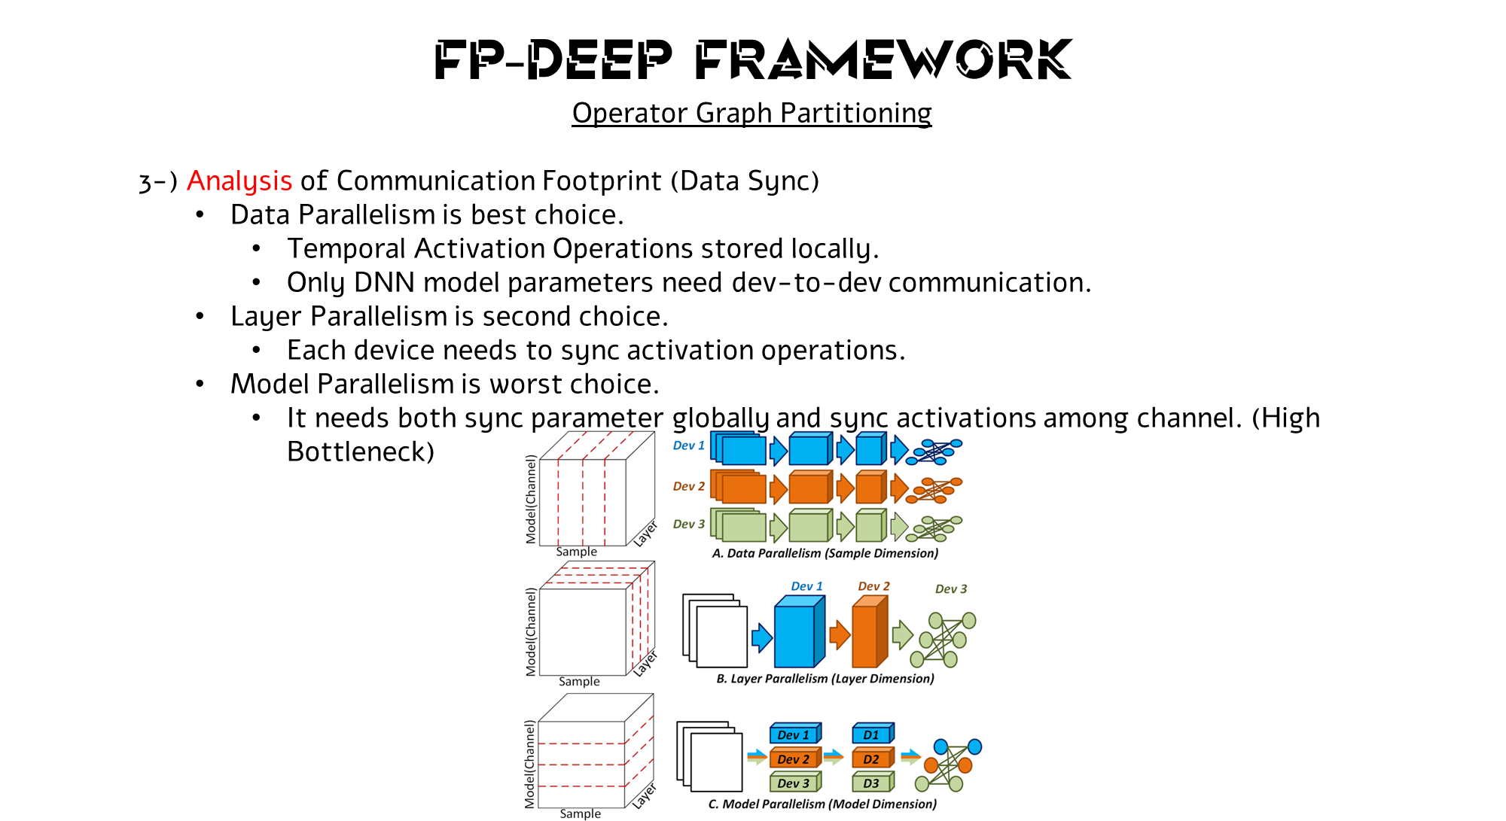
Notes:
Analizleri yaparak CNN Mimarisine göre neye ihtiyacı olduğunu anlar ve Hybrid bir çözüm sunma kabiliyeti ortaya koyar.
Operator Graph Partitioning Model realizes this.

Slide 14
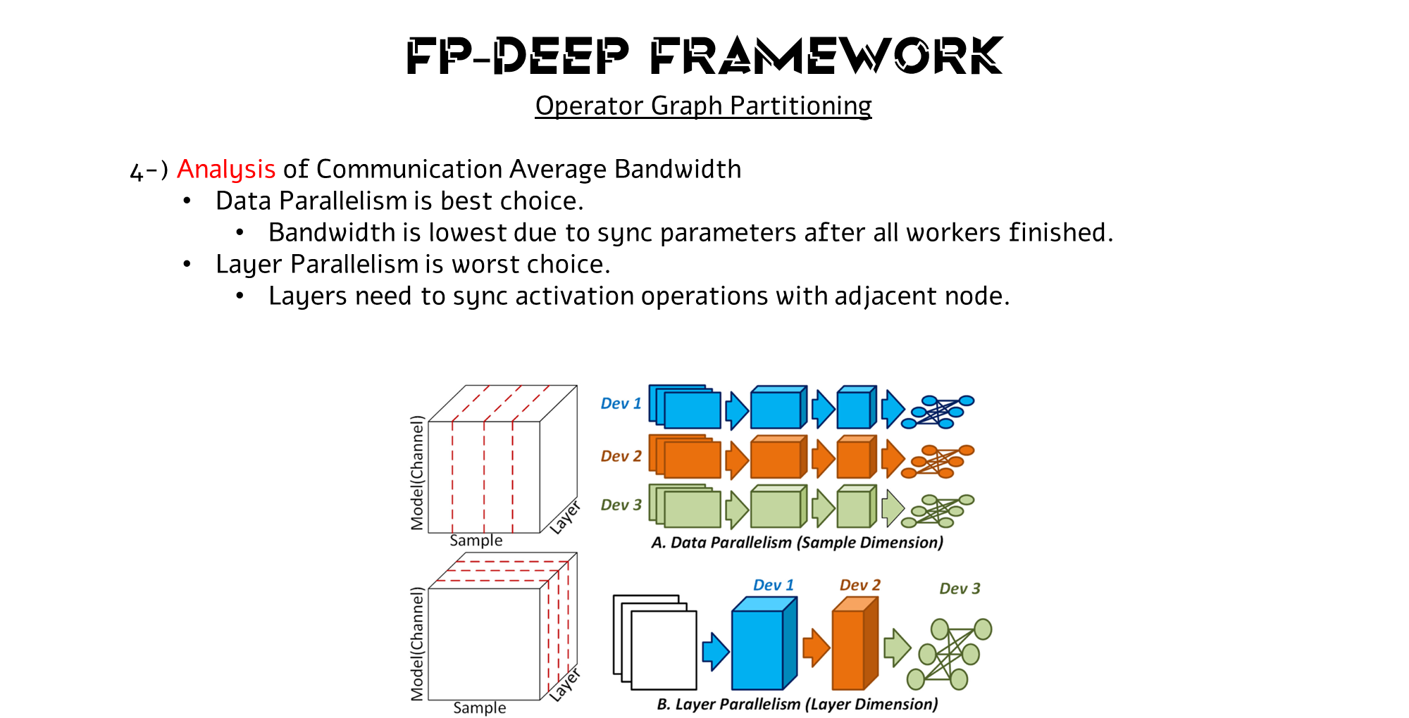
Notes:
Analizleri yaparak CNN Mimarisine göre neye ihtiyacı olduğunu anlar ve Hybrid bir çözüm sunma kabiliyeti ortaya koyar.
Operator Graph Partitioning Model realizes this.

Slide 15
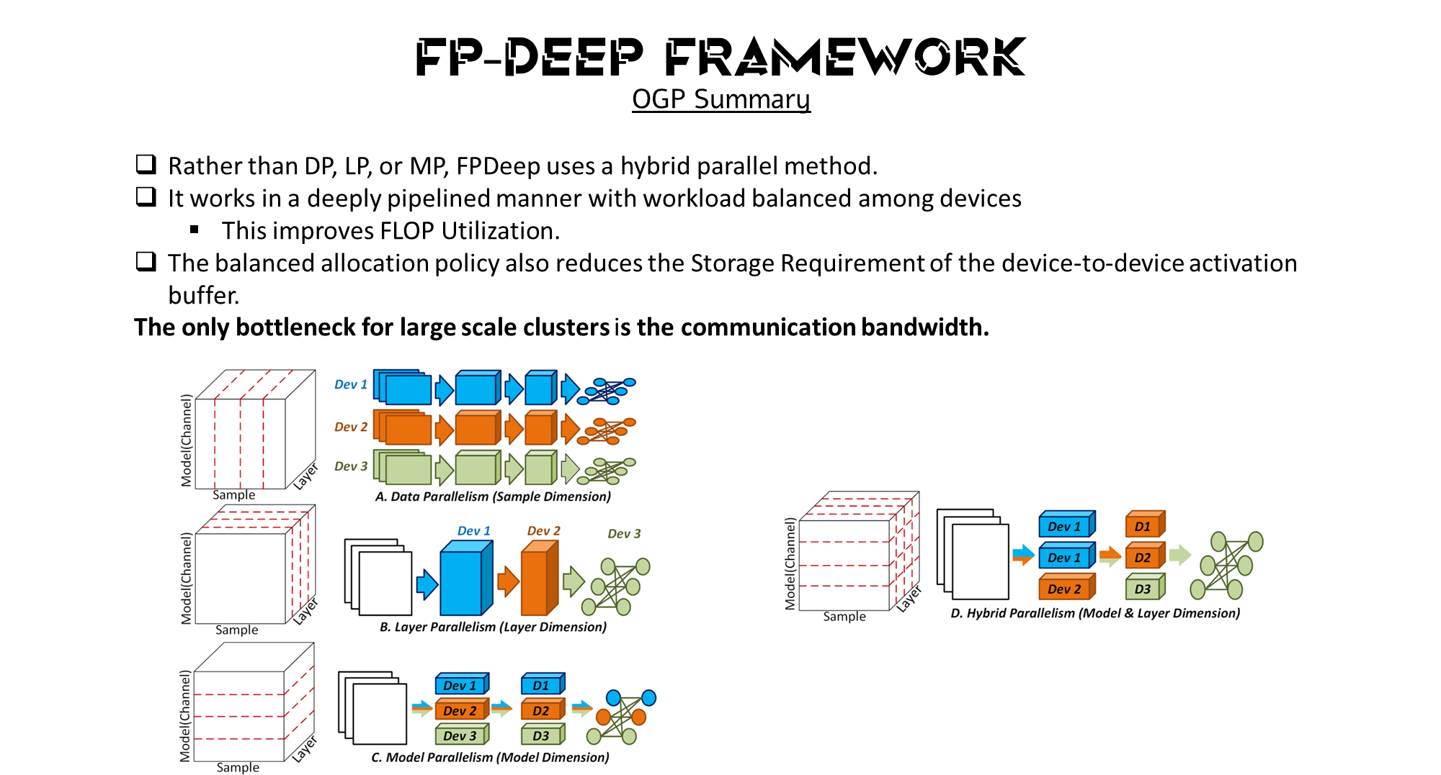
Notes:
Analizleri yaparak CNN Mimarisine göre neye ihtiyacı olduğunu anlar ve Hybrid bir çözüm sunma kabiliyeti ortaya koyar.
Operator Graph Partitioning Model realizes this.

Slide 16
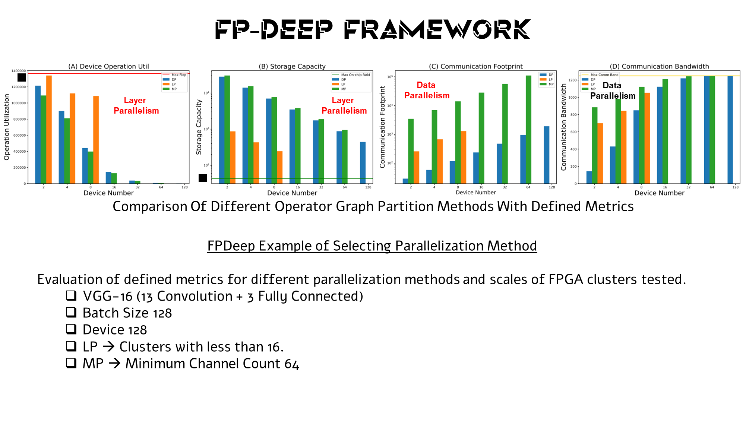
Notes:
Analizleri yaparak CNN Mimarisine göre neye ihtiyacı olduğunu anlar ve Hybrid bir çözüm sunma kabiliyeti ortaya koyar.
Operator Graph Partitioning Model realizes this.

Slide 17
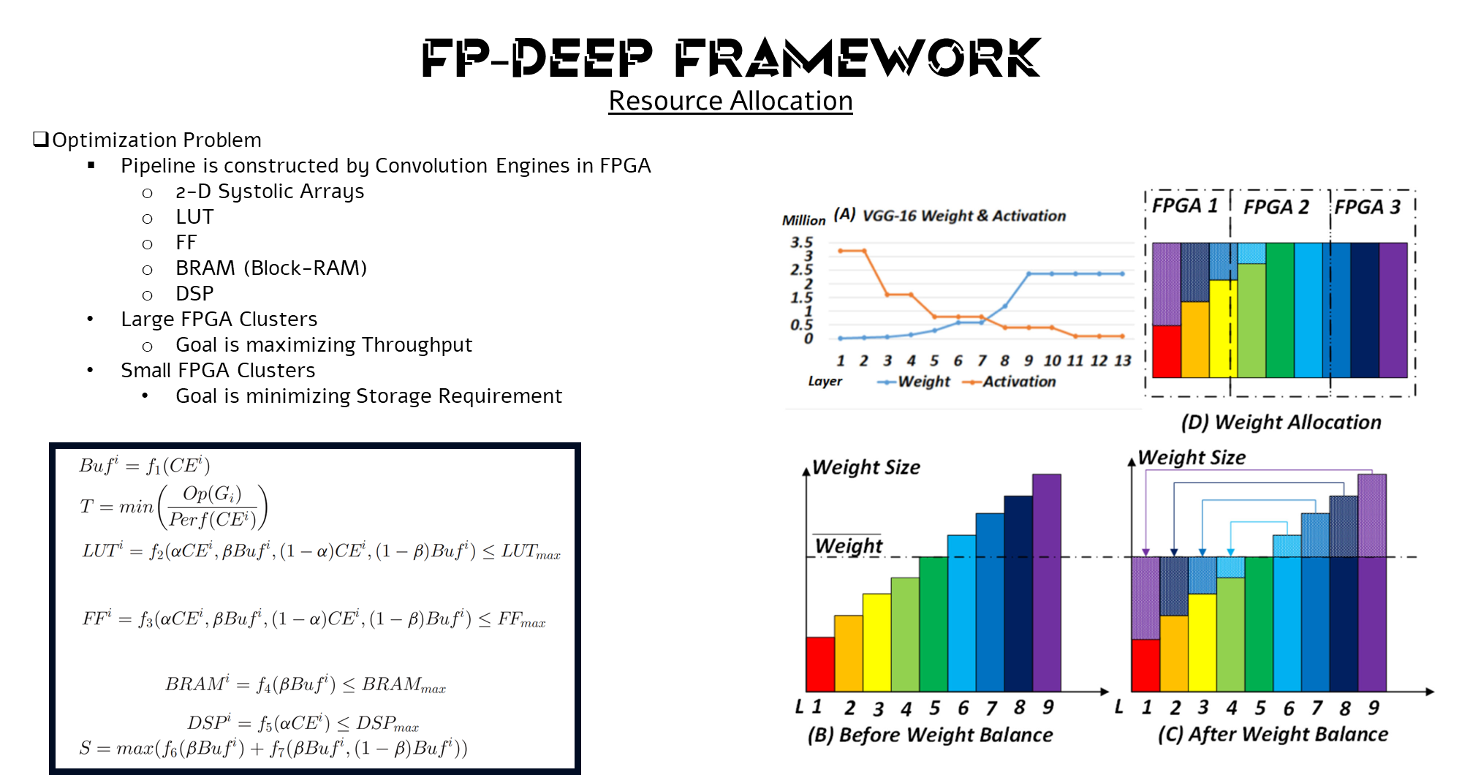
Notes:
Observe that from the first to the last layer the number of activations is decreasing while the number of parameters is increasing. The decrease in activations is because the dimensions of the feature maps are reduced by the pooling layers. The increase in the parameters is because the number of input and output channels increases in the later layers. In clusters with small numbers of FPGAs (to accelerate VGG-16) the memory demand of parameters for the later layers increases to the point where the on-chip memories in each FPGA are not big enough to cache the allocated parameters.
To make enable the mapping of big networks to small clusters of FPGAs, parameter balancing can be used. Figs. 6 B, 6c, and 6 D show the method. Simply, parameters from the later layers are stored in FPGAs where there is room, even if those FPGAs are some distance away from where those parameters will eventually be used. For example, the parameters of layer 8 are stored in FPGAs 3 and 1. During computation, the parameters stored in FPGA 1 are transferred to FPGA 3 through the communication network together with activations. Note that the transport of parameters does not tighten the constraint on inter-FPGA communication. This is because the smaller number of activations in the later layers cancels out the added traffic for the parameters. Our experiments demonstrate the benefit of this approach: only on-chip memory is needed for the CONV layers.

Slide 18
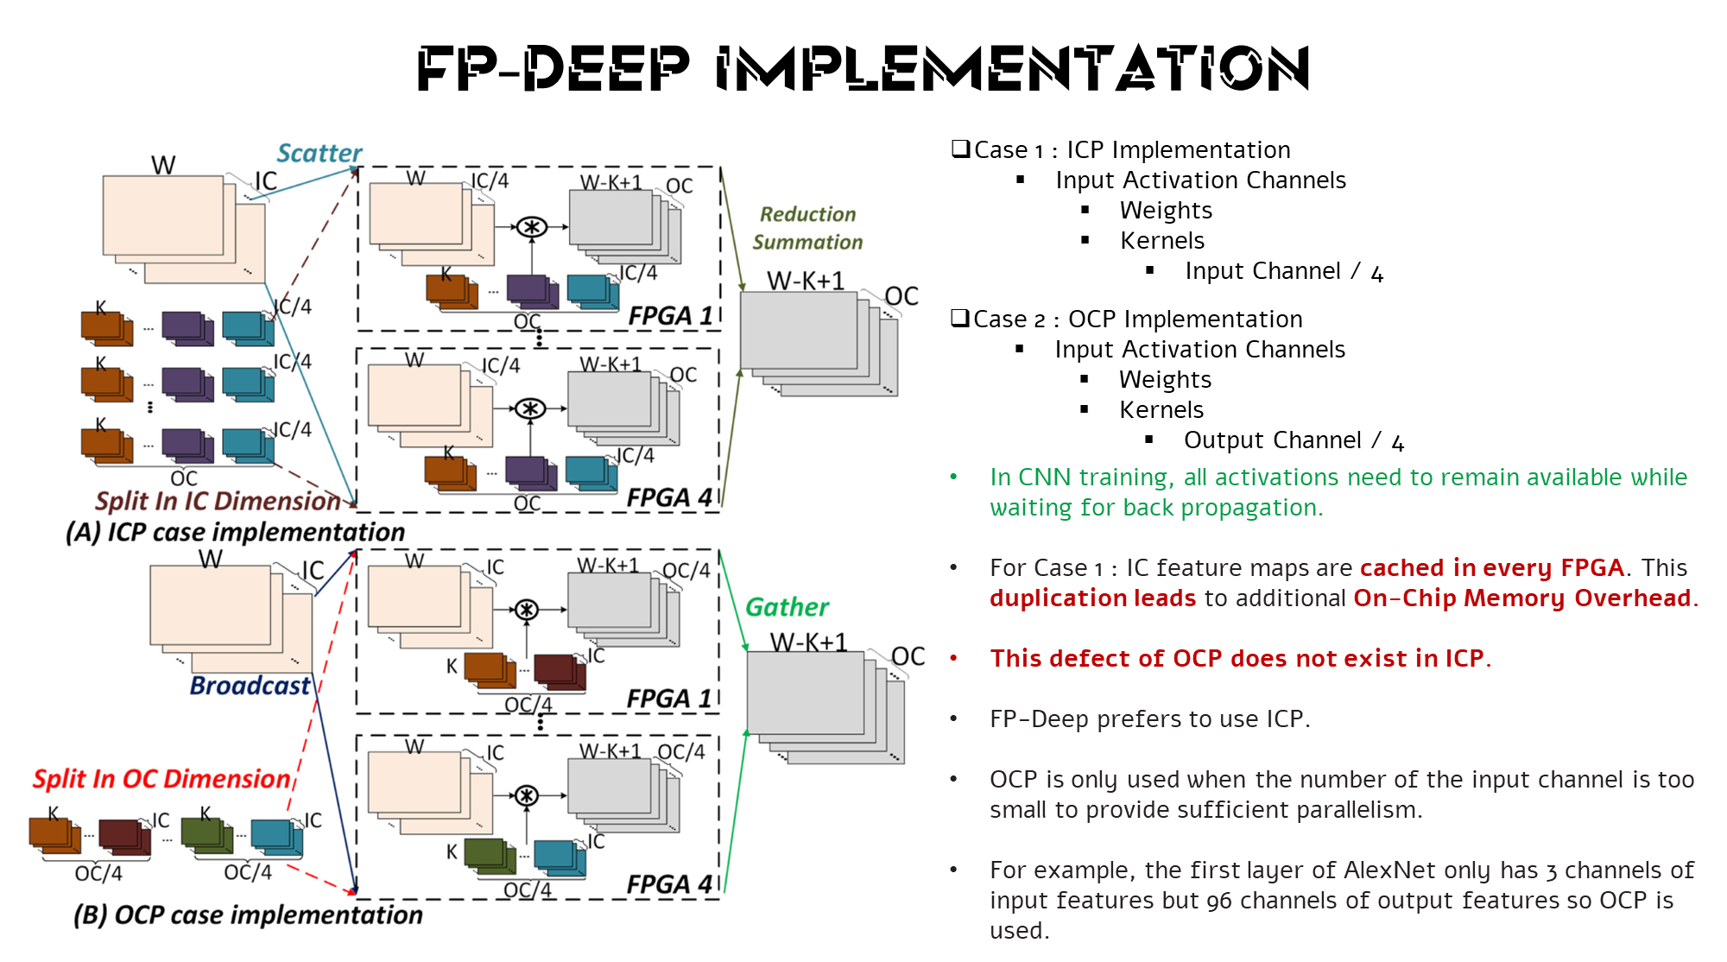
Notes:
In CNN training, all activations need to remain available while waiting for back propagation. Therefore, all IC feature maps are cached in every FPGA.
This duplication leads to additional onchip memory overhead.
This defect of OCP does not exist in ICP
FPDeep prefers to use ICP
OCP is only used when the number of the input channel is too small to provide sufficient parallelism.
For example, the first layer of AlexNet only has 3 channels of input features but 96 channels of output features so OCP is used.

Slide 19
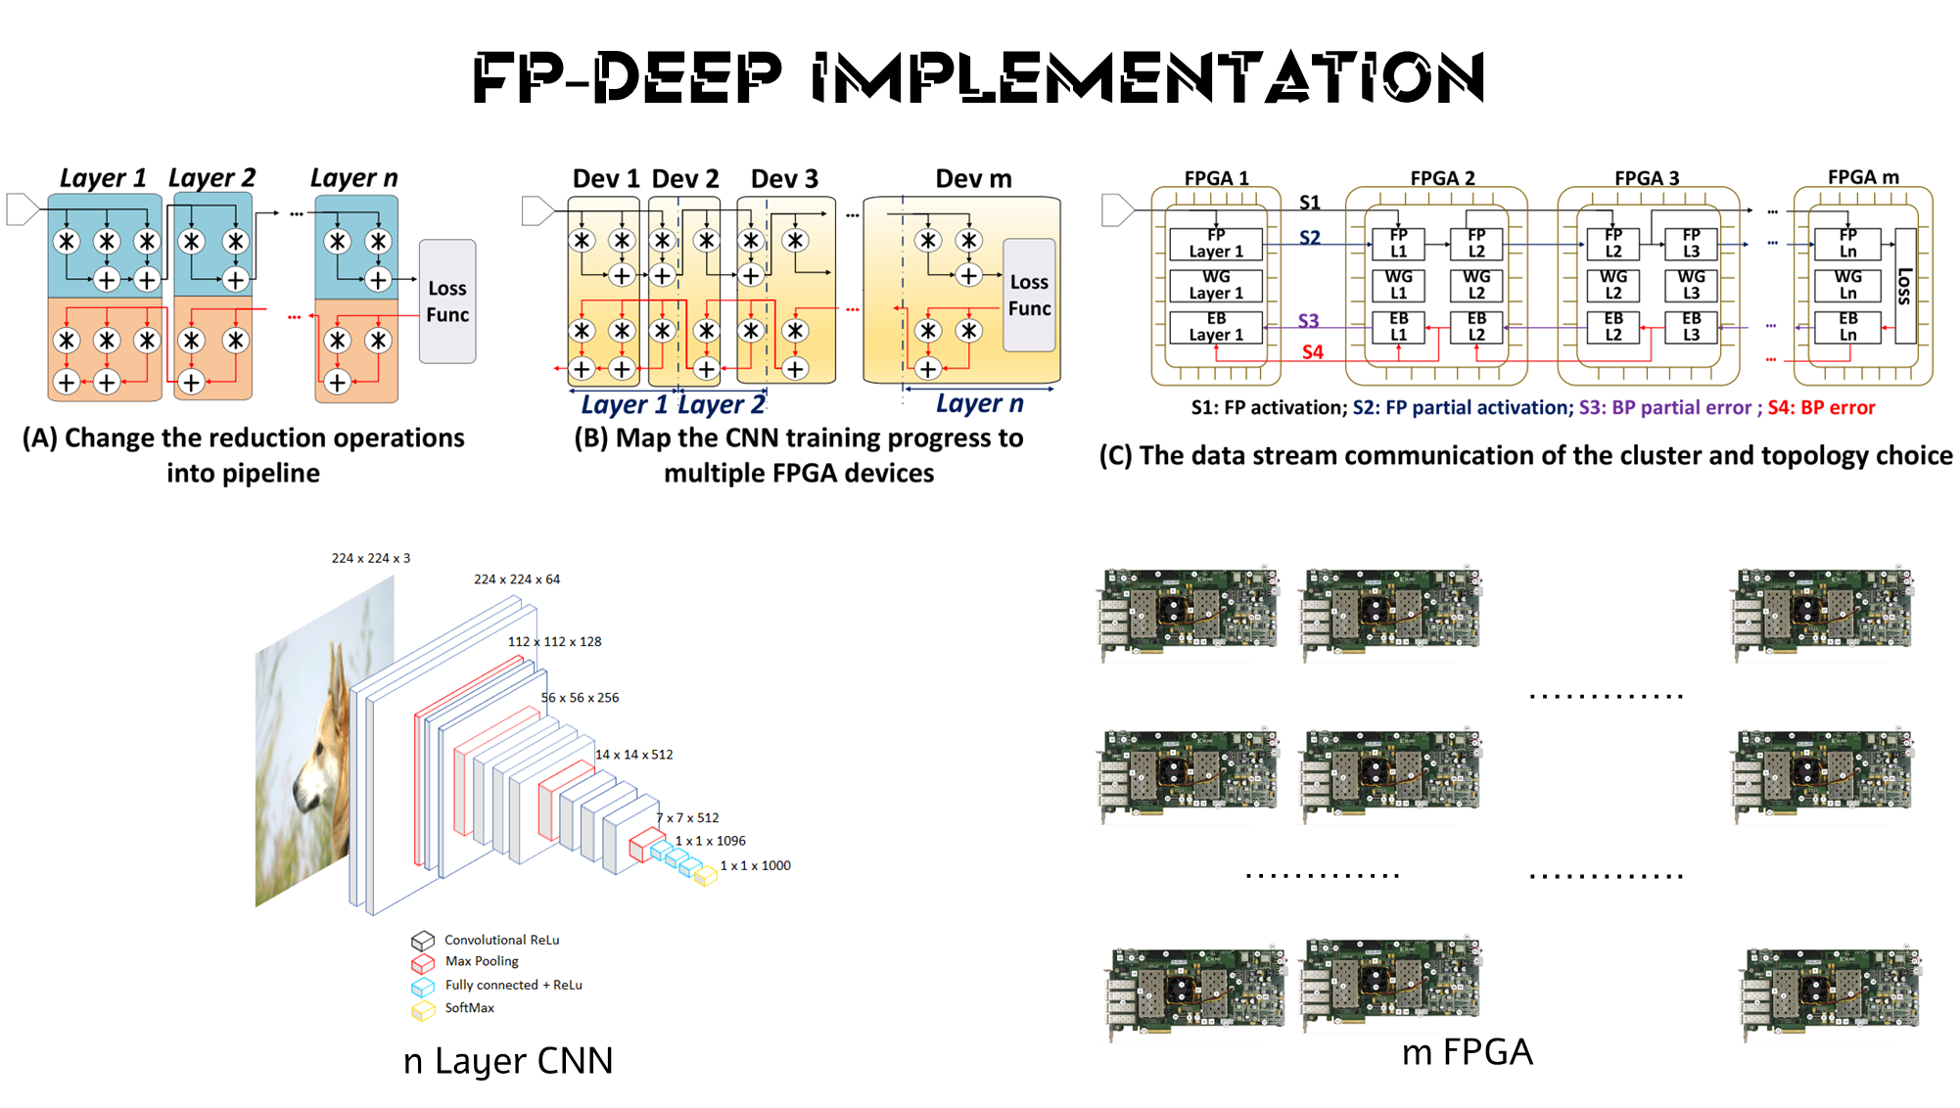
Notes:
Data flow analysis of CNN training. FPDeep pipelines the reduction operations and maps them to multiple FPGAs

Slide 20
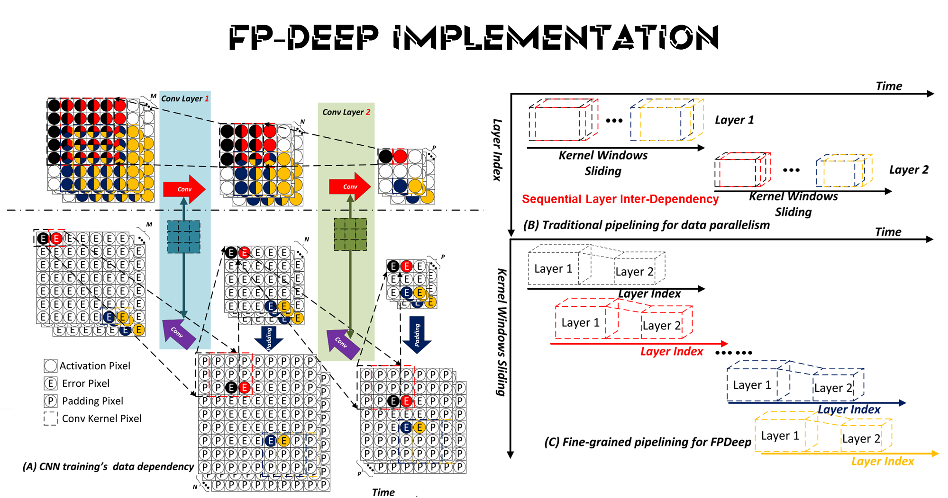
Notes:
At the end of the day we have lots of computation process and operations.
Convolution, Padding, Pooling, Activation, Error Calculation and so much more.
But we are moving our organization to the different paradigm.
We have sequential inter dependency between layers in Traditional Pipeline.
We have no sequential dependency in new paradigm

Slide 21
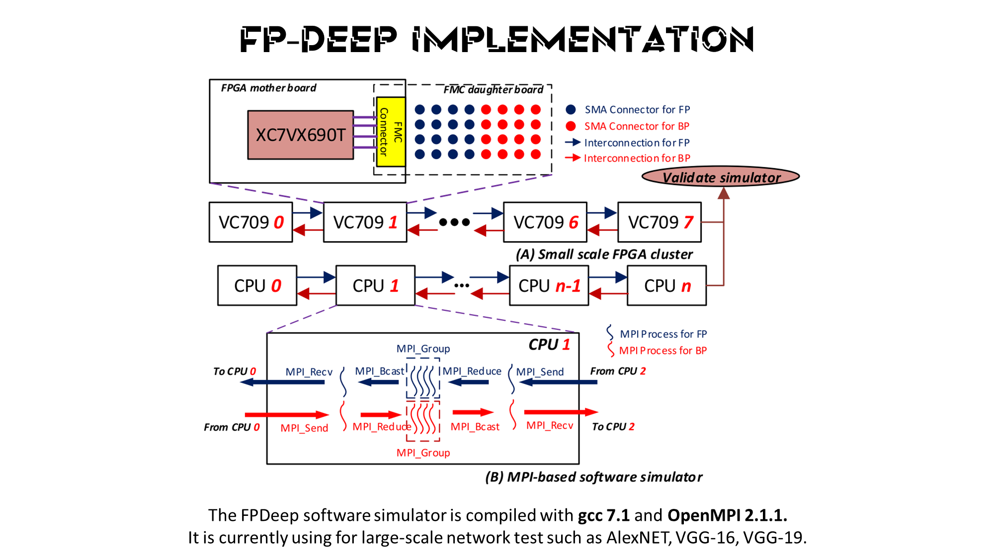
Notes:
We have MPI Process for forward propagation and backward propagation.
They are doing this by MPI Groups.
Creating an architecture

Slide 22
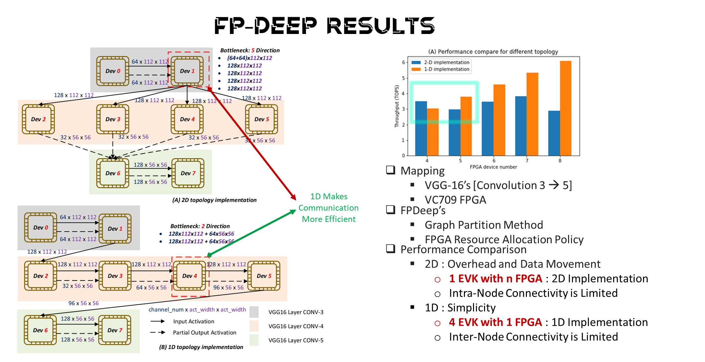
Notes:
Here is a performance comparation.
Mapping → According to → FPDeep
Overhead and Data Movement
The red dotted box marks the communication bottleneck.
Let us assume 10 board-to-board interconnections ports.
With a 2D topology. We see that Dev-1 is the bottleneck: because the degree of Dev-1 is 5, each communication link of Dev-1 only has two ports.
With a 1D topology, Dev-4 is the bottleneck.
Some of the partial output activations need to be duplicated (dotted arrows in and out of Dev-4).
But the degree of Dev-4 is only 2 while each communication link has 5 interconnection ports, making the communication more efficient.

Slide 23
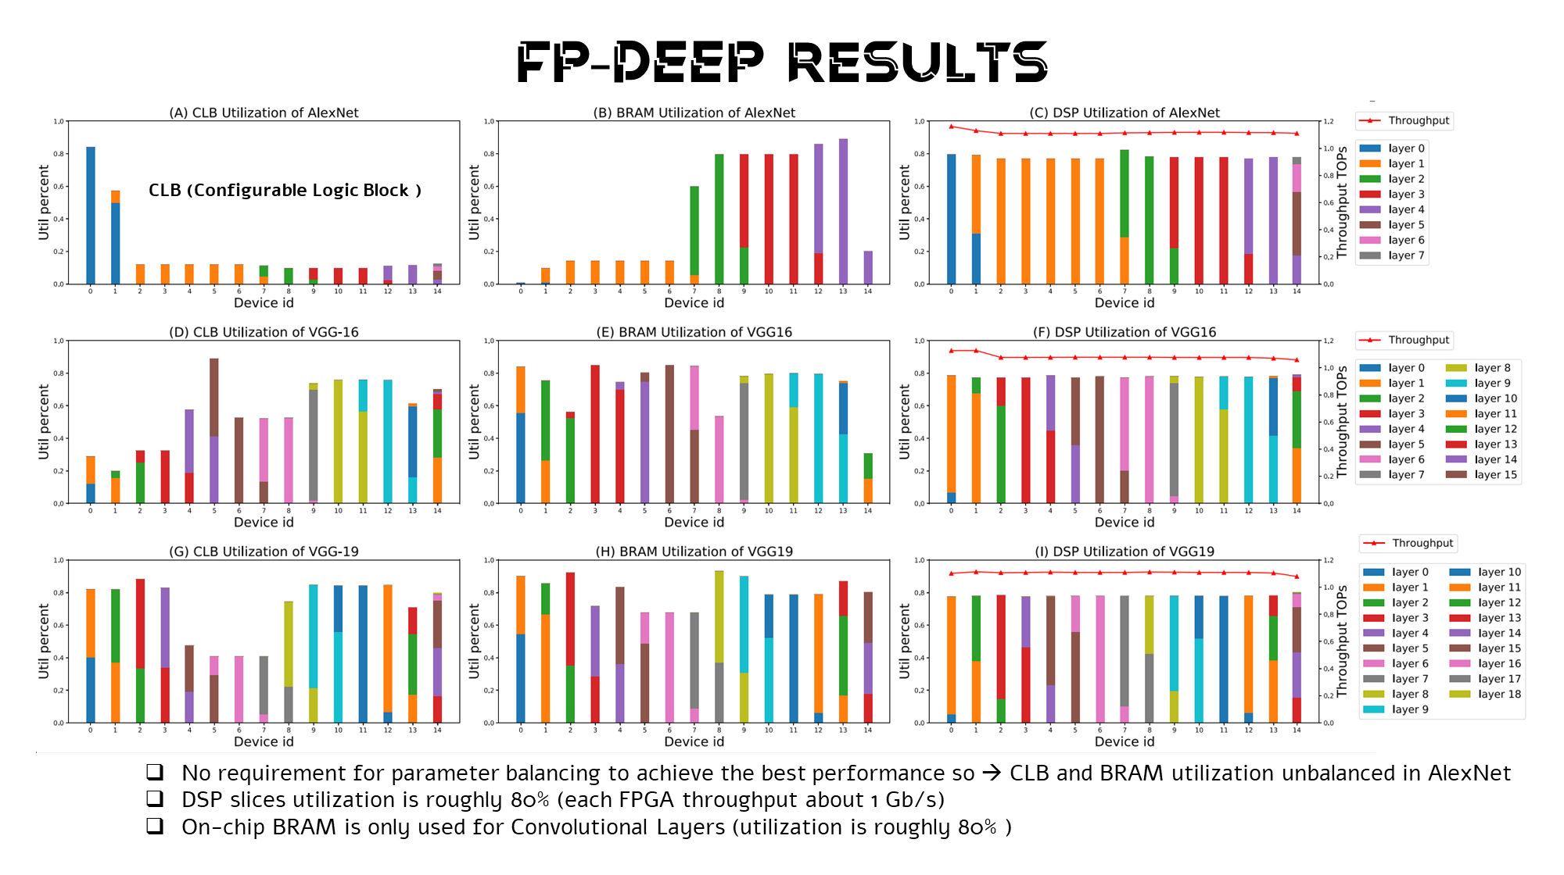
Notes:
15-node cluster does not require parameter balancing to achieve the best performance so CLB and BRAM utilization have been left unbalanced

Slide 24
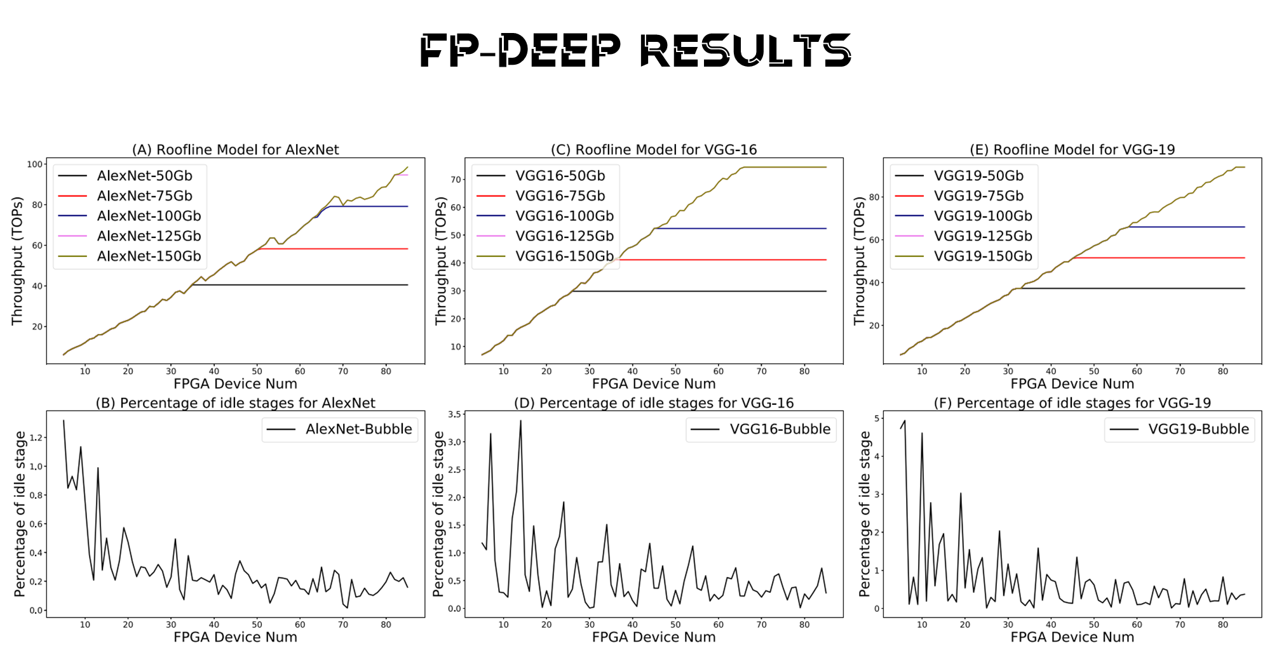

Slide 25
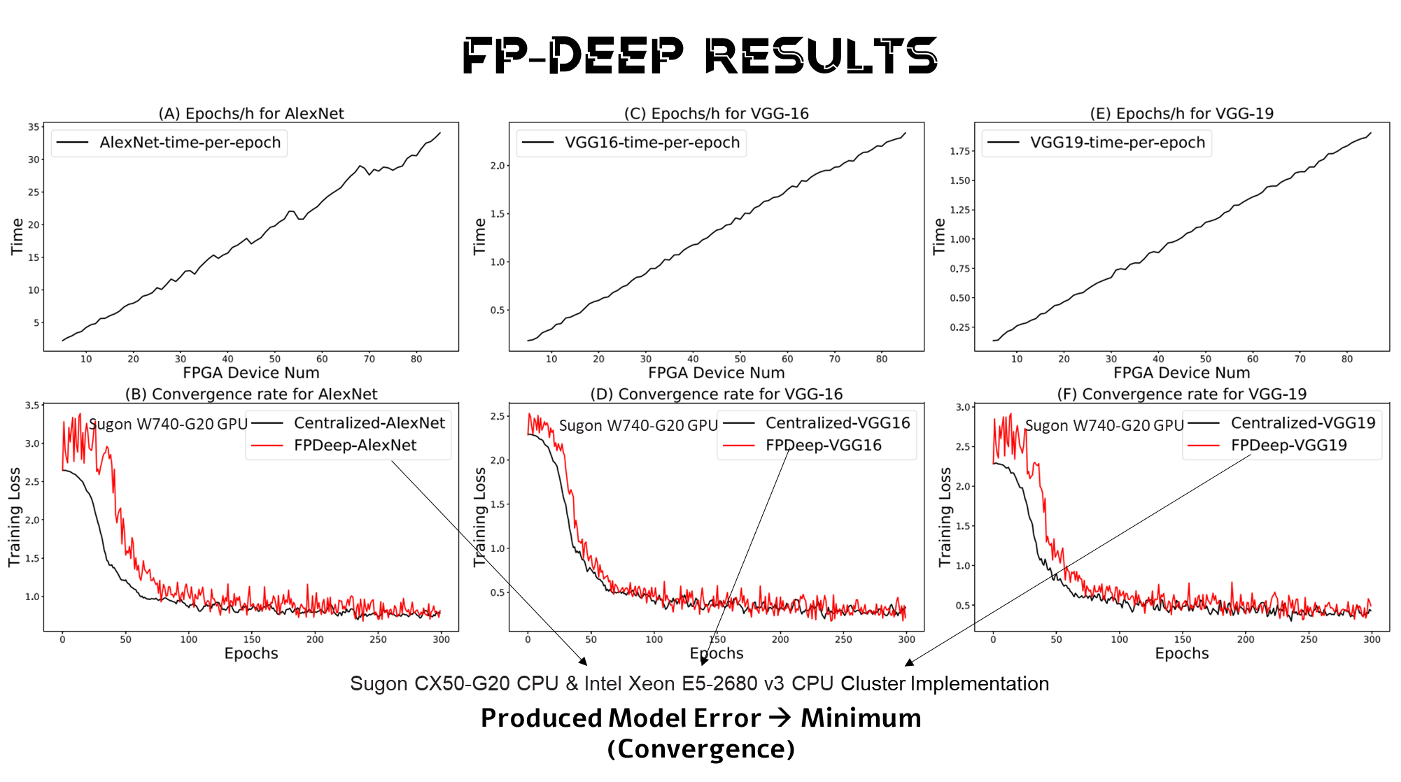
Notes:
Errors produced by the model in training comes to a minimum.

Slide 26
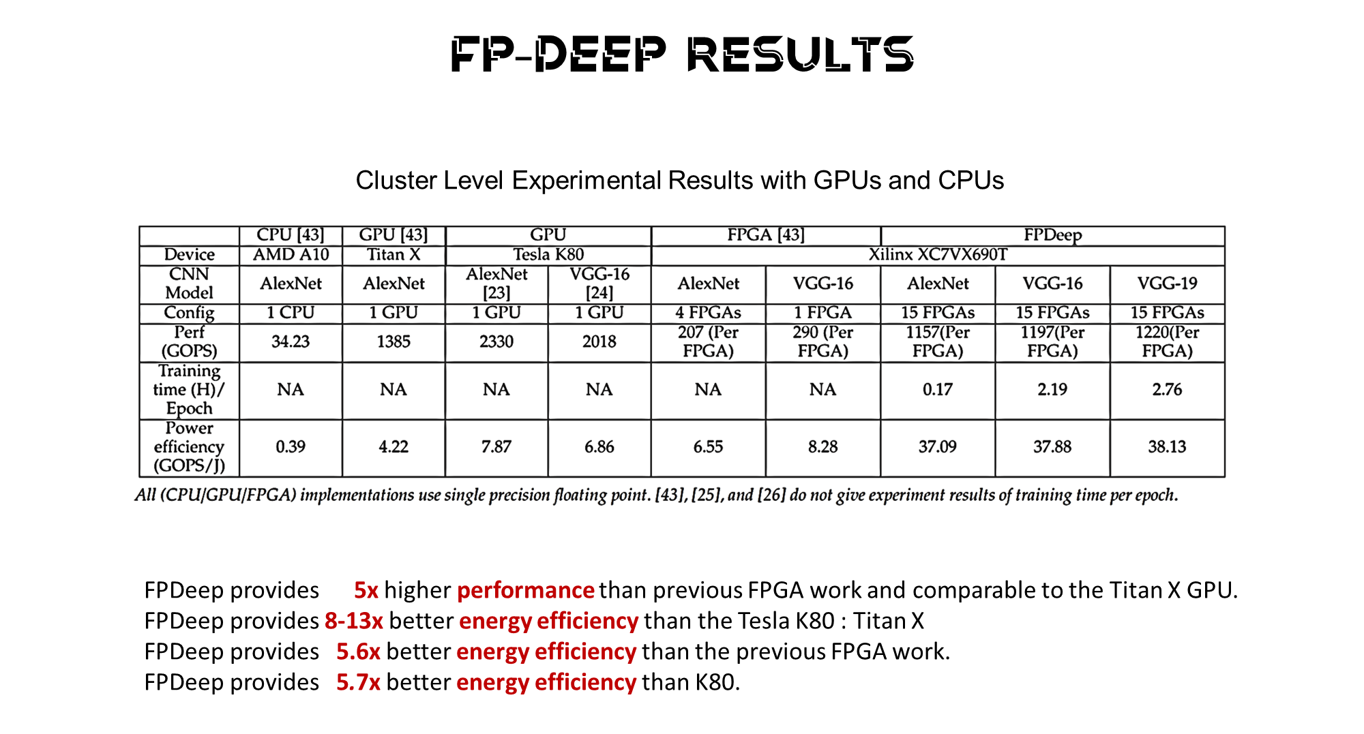
Notes:
[43] uses a workstation with an 8-core 3.8GHz AMD A10-5800K CPU and an Nvidia Titan X GPU. We use a server with Nvidia Tesla K80 GPUs as the golden model and baseline design. OpenBLAS and cuDNN libraries are used in software implementations. [43]’s CPU & GPU and our GPU implementation are all based on data parallelism, while [43]’s FPGA design is based on layer parallelism; the latter results in inter-board workload imbalance. The power consumption of all baseline and FPDeep systems are boardlevel and measured with a power meter. FPDeep provides performance 5× higher than previous FPGA work and comparable to the Titan X GPU. We evaluate energy efficiency with respect to GOPs/J. FPDeep provides 8:8× better energy efficiency than the Titan X and 5:6× better than the previous FPGA work. Compared with the K80, FPDeep provides 5:7× better energy efficiency.
GOPS – Giga Operations Per Seconds

Slide 27
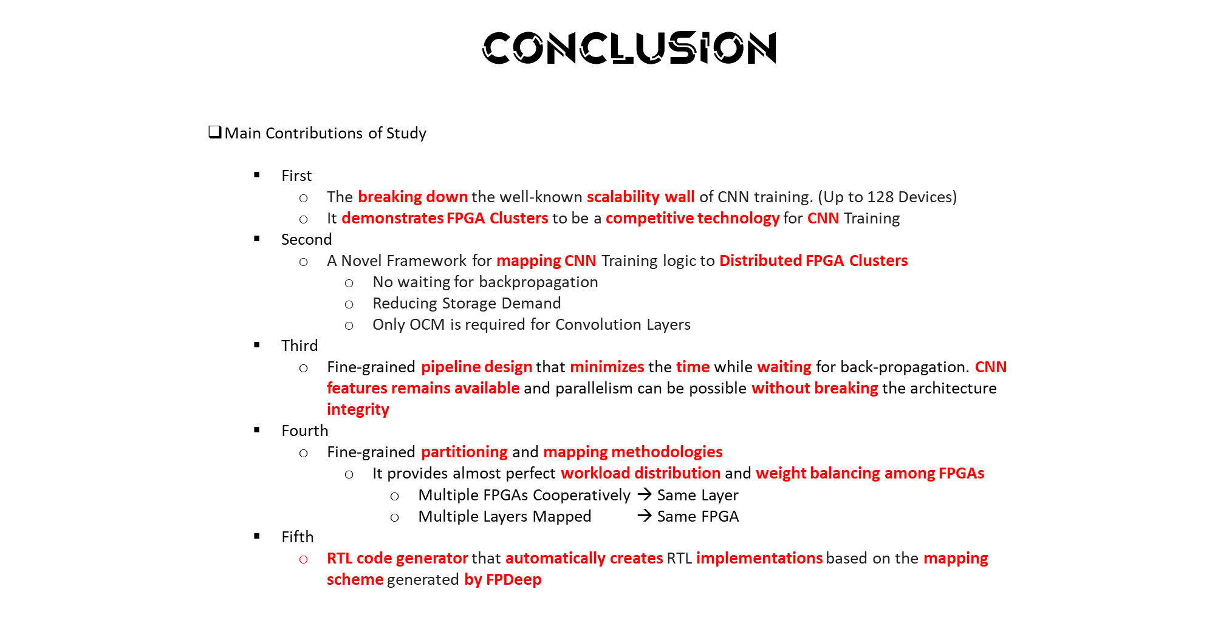
Notes:
Main Contributions of Study
First
The breaking down the well-known scalability wall of CNN training. (Up to 128 Devices)
It demonstrates FPGA clusters to be a competitive technology for CNN training
Second
A novel framework for mapping CNN training logic to distributed FPGA clusters.
No waiting for backpropagation
Reducing storage demand
Only OCM is required for convolution layers
Third
A Fine-grained pipeline design that minimizes the time while waiting for back-propagation. CNN features remains available and parallelism can be possible without breaking the architecture integrity.
Fourth
A Fine-grained partitioning and mapping methodologies
It provides almost perfect workload distribution and weight balancing among FPGAs.
multiple FPGAs can cooperatively compute the same layer with improved utilization.
multiple Layers can also be mapped to the FPGA device.
Fifth
An RTL code generator that automatically creates RTL implementations based on the mapping scheme generated by FPDeep.

Slide 28
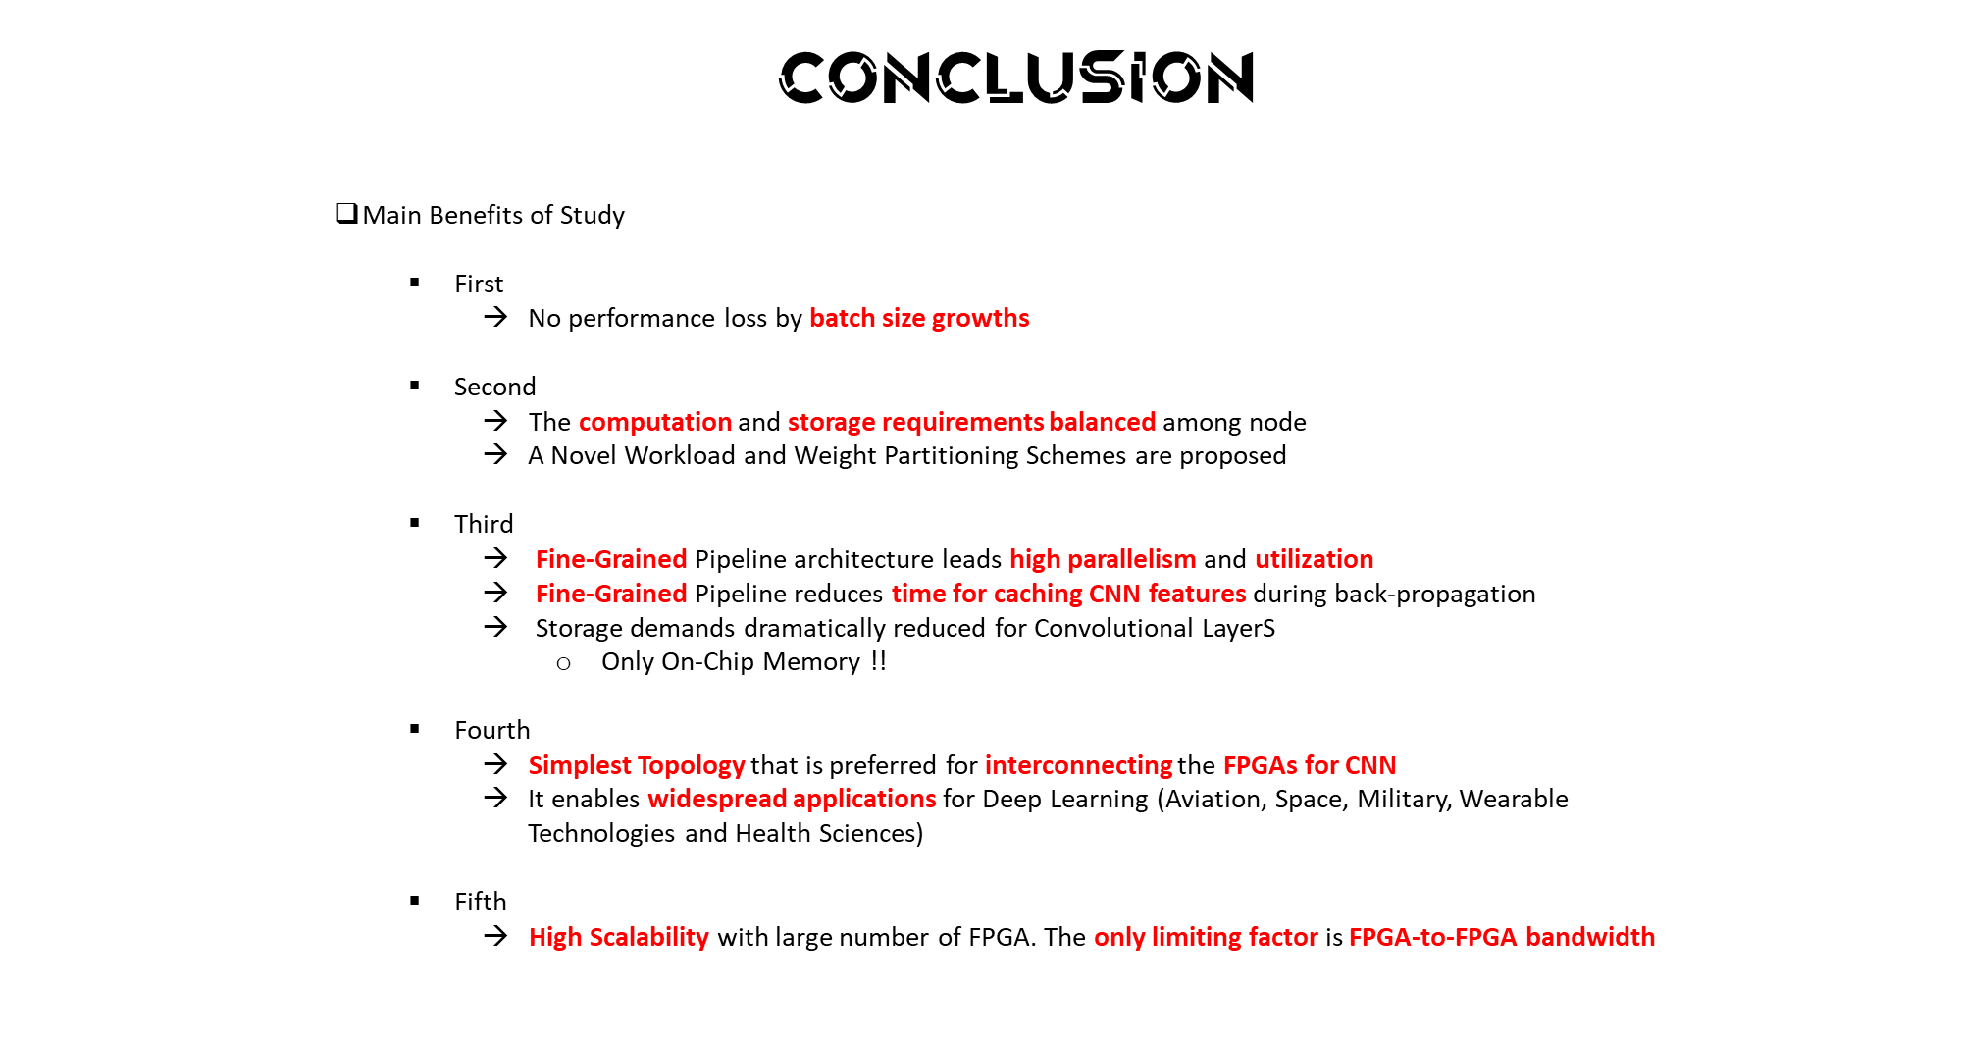

Slide 29
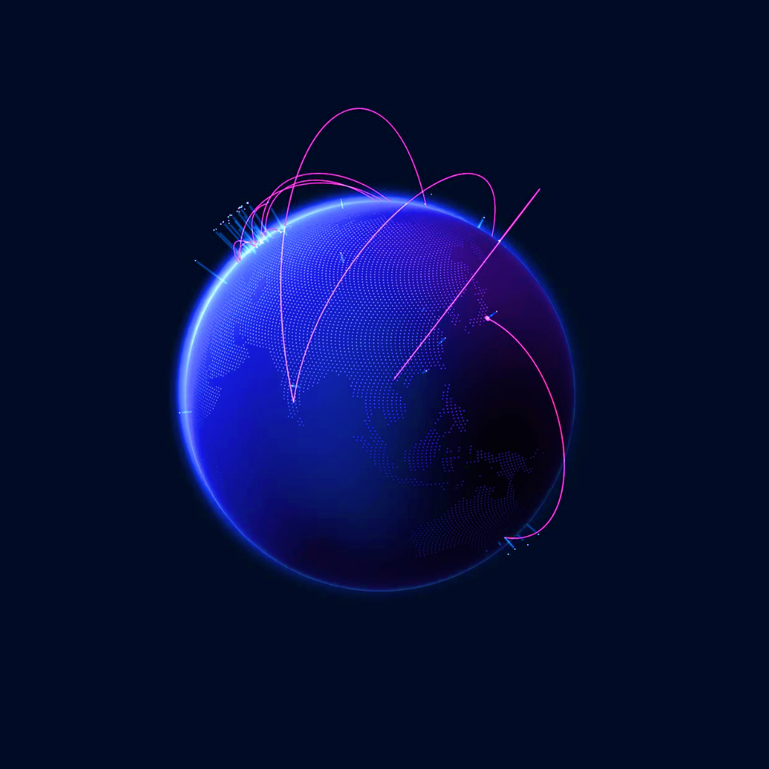
Team work
Thank you

